Slide 1
Diabetes: From Endothelial Dysfunction to Overt Atherosclerosis
1o Πανελλήνιο Συνέδριο ESODiMESO
October 12, 2014
Georgios I. Papaioannou, MD, MPH, FACC, FSCAI
Director, Interventional Cardiology Department
Athens Medical Center

Slide 2
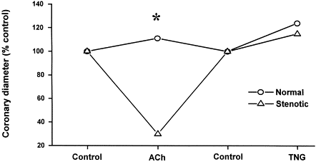
Paradoxical vasoconstriction induced by acetylcholine in atherosclerotic coronary arteries
Ludmer et al. N Engl J Med 1986;315:1046-51

Slide 3
Detection of Endothelial dysfunction
Selective endothelial dysfunction may occur in the absence of angiographic or ultrasound atherosclerosis and in patients with risk factors for coronary disease (J Am Coll Cardiol 1994;23:833-43)
Non-invasive detection of endothelial dysfunction in children and adults at risk of atherosclerosis (Lancet 1992;340:1111-15)
Close relationship of endothelial function in the human coronary and peripheral circulations (J Am Coll Cardiol 1995;26:1235-41)

Slide 4
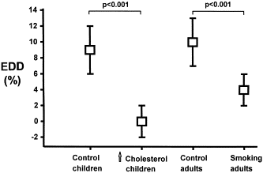
Endothelial dysfunction is important in the early stages of atherogenesis
Significantly impaired endothelium FMD (EDD) is present in asymptomatic children and young adults with risk factors for atherosclerosis. Celermajer et al, Lancet 1992;340:1111-15.

Slide 5
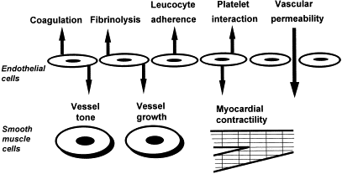
Functions of normal endothelium
ICAM-1
VCAM-1
thrombin
t-PA
Prostacyclin ↓
NO, Prostacyclin / AT-1, ET-1
J Am Coll Cardiol 1997;30:325-33

Slide 6
Endothelium
Monocyte
Oxidized LDL
Foam Cell
Macrophage
Mast
Cell
Cytokines
T-lymphocyte
Notes:
1

Slide 7
Arterial Injury-Endothelial Dysfunction (CAUSES)
Traditional (2/3)
Hypertension
Smoking
DM
Hyperlipidemia <50%
Family History
Obesity, Sedentary, Type A, Male
Novel
Infection
Chlamydial
Periodontal
Allergy/Inflammation
Homocysteine
Air Pollution

Slide 8
Endothelial Dysfunction (CONSEQUENCES)
Loss of vasodilatory ability (⬇ NO)
Increased platelet aggregation (⬇ NO)
Increased adhesion molecule expression
Monocyte, T-lympocyte, and Mast cell recruitment
Initiation of local inflammation
Collagen destruction (“soft-vulnerable plaque”)
Cytokine production

Slide 9
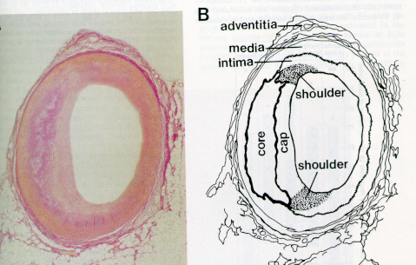
The “Shoulder Region”
Most common site of plaque rupture.
Border of atheroma with normal intima.
Site of intense inflammatory cell accumulation.
Activated mast cells present.

Slide 10
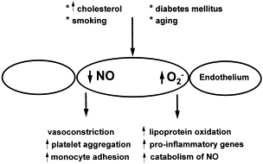
Endothelial dysfunction: The risk of the risk factors
J Clin Invest 1993;92:1886-94

Slide 11
Endothelial dysfunction and clinical applications
Relation to myocardial ischemia
Correlation with prognosis
Effect of therapy on endothelial function
Improved endothelial function correlates with improved clinical outcomes

Slide 12
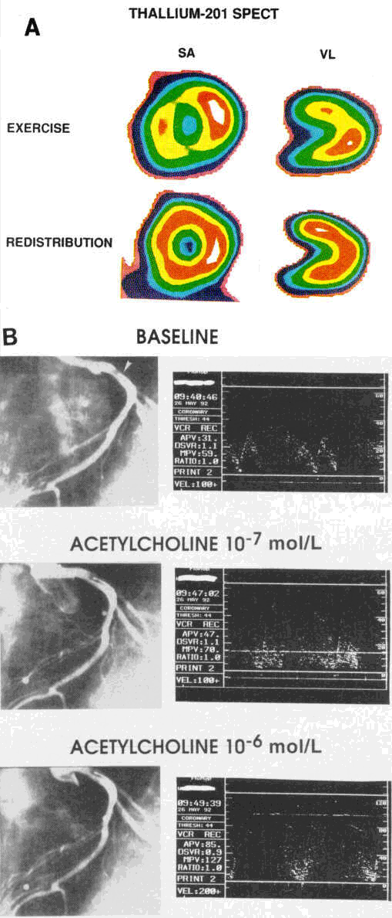
Relation with Myocardial ischemia
A: Thallium-201 SPECT imaging during exercise (top) and at redistribution (bottom), demonstrating moderate to severe reduction of uptake of radiotracer indicative of myocardial ischemia in the anterior wall (SA indicates short axis; VL, vertical long axis). B: Coronary angiography (left panels) and intracoronary Doppler flow velocity tracings (right panels) at baseline and during increasing acetylcholine infusion into the left anterior descending artery (arrow denotes tip of infusion catheter) of the patient with exercise-induced thallium perfusion abnormality illustrated in A. Note absence of flow-limiting epicardial artery constriction
Zeiher et al. Circulation 1995;91:2345-2352

Slide 13
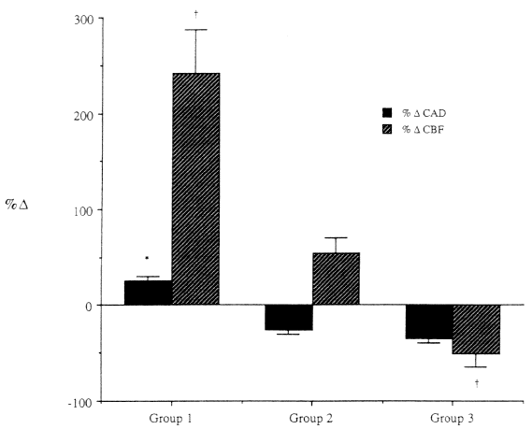
Relation with Myocardial ischemia
Maximal effect of acetylcholine infusion (10⁻⁴ mol/L) in the LAD expressed as mean percent change in CAD (%Delta CAD) and in CBF (%Delta CBF) relative to baseline. *P < .05 relative to %Delta CAD for group 2; (dagger)P < .05 relative to %Delta CBF for group 2.
Group 1: MPI in non-LAD
Group 2: No MPI
Group 3: MPI in LAD
Hasdai et al. Circulation 1997;96:3390-3395

Slide 14
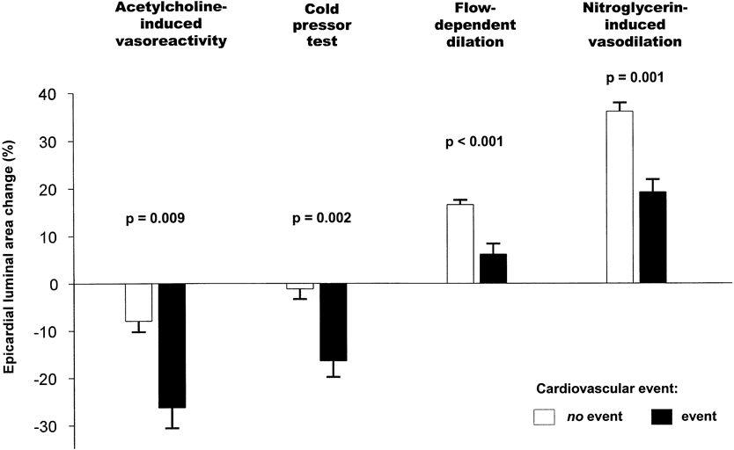
Correlation with prognosis
Epicardial luminal area changes in response to various vasoreactivity tests in patients with (filled columns) and without (open columns) cardiovascular events during long-term follow-up. Data are shown as mean ± SEM. (Circulation 2000;101:1899-1906)

Slide 15
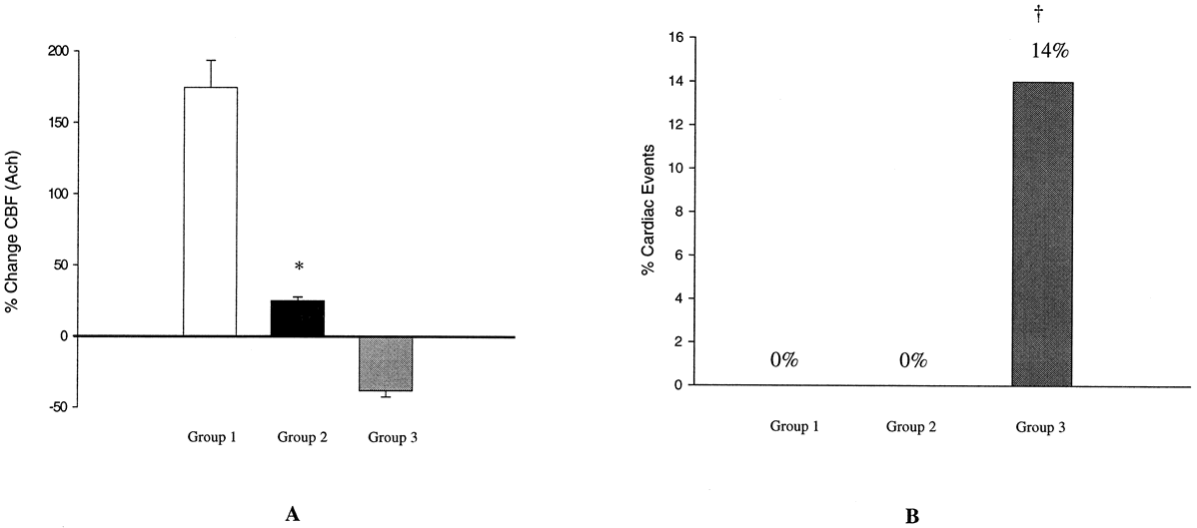
Long term follow up of patients with CAD and endothelial dysfunction
A: Mean percent change in CBF in response to acetylcholine (Ach) among 3 groups. *P <0.0001 vs groups 1 and 3. B: Cardiac events (myocardial infarction, PCI, CABG, and/or cardiac death). †P <0.05 vs groups 1 and 2. Groups 1,2,3: Normal, Mild and severe endothelial dysfunction. Circulation 2000;101:948-954

Slide 16
Effects of therapy on endothelial dysfunction
Cholesterol lowering
Antioxidants
ACE Inhibitors
Metformin
Hormone replacement therapy
Exercise
L-arginine

Slide 17
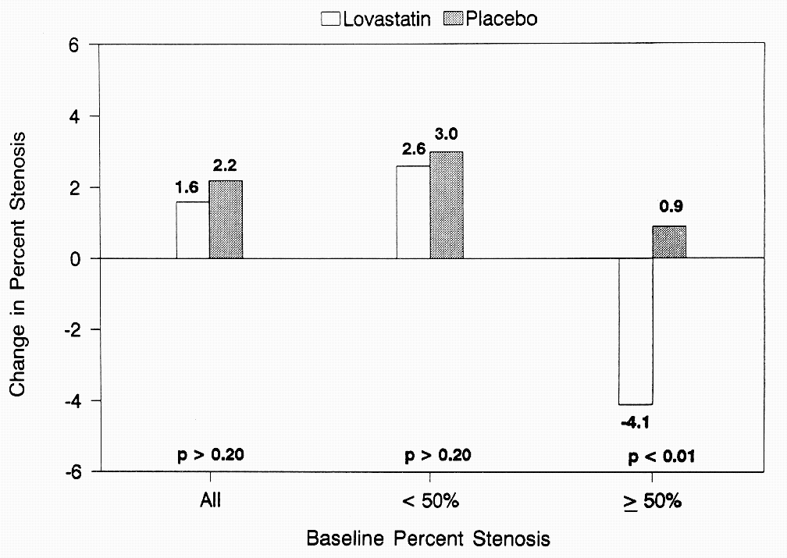
MARS Study: Coronary angiographic changes with Lovastatin therapy
Average change in percent diameter stenosis as determined by quantitative coronary angiography. After adjusting for the percent diameter stenosis at baseline, analysis of covariance was carried out for all lesions (114 patients in the lovastatin group, 106 in the placebo group), small lesions (<50% stenosis) at baseline (112 patients in the lovastatin group, 105 in the placebo group), and large lesions (>=50% stenosis) at baseline (77 patients in the lovastatin group, 79 in the placebo group)
Annals Intern Med 1993;119:969-76

Slide 18
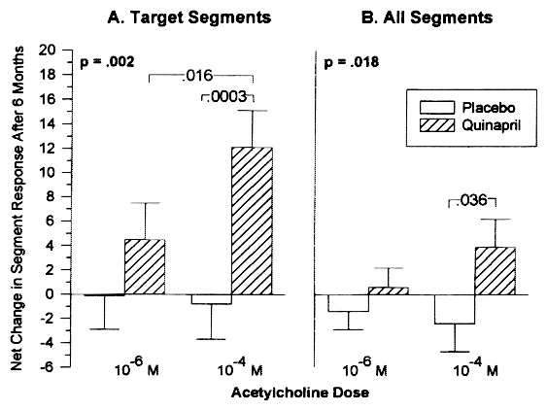
TREND Study: ACE Inhibition with Quinapril improved endothelial dysfunction in normotensive patients without severe hyperlipidemia
A: The primary efficacy parameter (net change in segment response after 6 months in the target segment, expressed as a percent +/- SE, plotted on y axis) for two concentrations of acetylcholine (x axis). B: Analysis of all segments. Overall differences in response between the placebo and quinapril groups were significant for the target segment analysis (P = .002) and for all segments (P = .018). At the 10 sup -4 mol/L dose, the difference between the placebo and quinapril groups was significant for both the target vessel analysis (P < .0003) and for all segments (P = .036).
Mancini et al. Circulation 1996;94:258-265

Slide 19
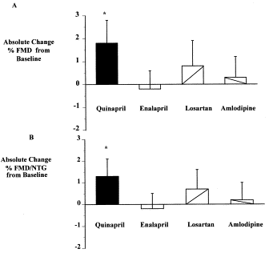
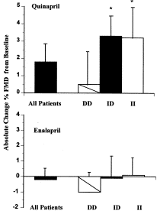
BANF Study: ACE Inhibition and endothelial function (J Am Coll Cardiol 2000;35:60-6)
A: The absolute change in percent FMD following therapy compares with pretreatment baseline values. Only quinapril resulted in a significant improvement in brachial flow-mediated vasodilation (*p < 0.02). B: The absolute change in the ratio of percent FMD/nitroglycerin-induced vasodilation following therapy compared with baseline values. Again only quinapril resulted in significant improvement (*p = 0.03).
The absolute change in percent FMD following therapy compares with pretreatment baseline values for quinapril and enalapril based on ACE genotype. Significant improvement in FMD seen only in the quinapril group for the ID and II genotype (*p = 0.03).

Slide 20
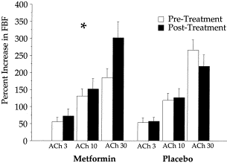
Figure 1. Endothelium-dependent blood flow responses before and after treatment with metformin. Doses are 3, 10 and 30 g/min. p = 0.0027 by two-way analysis of variance, comparing treatment effects in the two groups. ACh = acetylcholine; FBF = forearm blood flow.

Slide 21
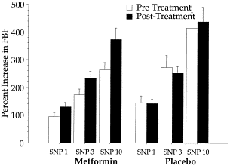
Figure 2. Endothelium-independent blood flow responses before and after treatment with metformin. Doses are 1, 3 and 10 g/min. P = 0.27 by two-way analysis of variance, comparing treatment effects in the two groups. SNP = sodium nitroprusside; FBF = forearm blood flow.

Slide 22
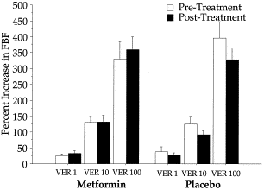
Figure 3. Nitrate-independent blood flow responses before and after treatment with metformin. Doses are 1, 10 and 100 g/min. P = 0.40 by two-way analysis of variance, comparing treatment effects in the two groups. VER = verapamil; FBF = forearm blood flow.

Slide 23
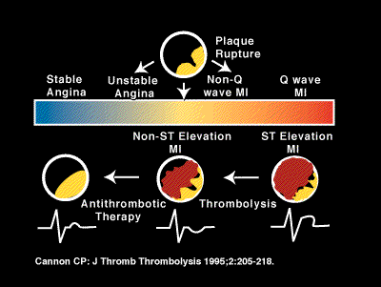
Pathophysiology of Acute Coronary Syndrome
Risk Factors-Endothelial dysfunction-Intima/Media Thickness-Calcification-Atherosclerotic Plaque
Notes:
This is the spectrum of acute coronary syndrome.
Mechanisms of thrombosis: endothelial erosion or plaque disruption.
This an atherosclerotic plaque that has ruptured.
The characteristics of a vulnerable plaque are:
- a large lipid core occupying at least 50% of the overall plaque volume
- a high density of macrophages
- low density of smooth muscle cells in the cap
- a thin plaque cap
Pathology studies support that a transmural infarct has homogennous consistency but a non-transmural infarct has a different structure which is built up by the coalescence of many small areas of necrosis of very different ages and appears to be caused by repetitive episodes of short lived occlusion or platelet embolization.

Slide 24
BRAZIL 1982 - The team of Dreams
Paolo Roberto Falcao
Socrates
Artunes Coimbra Zico

Slide 25
Assessment of Vascular Health (Endothelial Function)
Brachial artery studies (NO-mediated vasodilatation)
Coronary flow reserve measurements
Inflammatory marker measurements (acute phase reactants)
C-reactive protein
ESR
Fibrinogen
WBC #

Slide 26
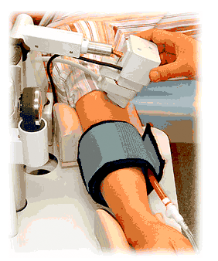
Brachial Artery Reactivity Testing

Slide 27
Why should we study the coronary microcirculation? (I)
Even the most seminal reactions, autoregulation and metabolic dilatation, are incompletely understood
CAD is not only an epicardial vessel disease
There is great difficulty in the clinical evaluation of coronary microcirculation. Remember Syndrome X?
Animal and human data suggest that dysfunction of coronary microcirculation can produce cardiac abnormalities. (e.g data with coronary infusion of ET1, data with measurement of CFR following PTCA)
Am J Physiol Heart Circ Physiol 2000;279:H2581-84.

Slide 28
Why should we study the coronary microcirculation? (II)
Identification of patients with paradoxical vasoconstriction during increases in O₂ consumption
Assess efficacy of various pharmacologic interventions who aim to produce dilation of coronary microcirculation
Administration of drugs that “target” the coronary circulation can improve outcomes of interventional techniques (PTCA, Stenting)
Am J Physiol Heart Circ Physiol 2000;279:H2581-84.

Slide 29
Mechanisms of Coronary Physiology
Angiographic Epicardial Stenosis
↓ Microvascular Resistance to maintain regional basal flow
↑ Resistance to Flow
Resting Post-stenotic Flow usually satisfactory
↓ of Potential CVR
Any increase in myocardial O2 demand results in ↓ CVR and ↓ rCVR and ischemia

Slide 30
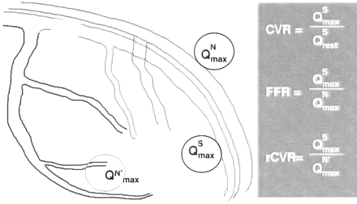
Diagrammatic definitions of CVR, FFR, and rCVR
Pa
Lesion
= Pd/Pa
Pd
A theoretically normal artery is drawn behind the stenotic artery. CVR is determined by maximal stenosis flow (Q^{S}_{max}) divided by stenosis artery flow at rest (Q^{S}_{rest}). FFR is determined by maximal stenosis flow (Q^{S}_{max}) divided by maximal theoretical normal artery flow (Q^{N}_{max}). rCVR is determined by maximal stenosis flow (Q^{S}_{max}) divided by maximal normal adjacent artery flow (Q^{N}'_{max}) Circulation 2001;103:3142-3149.

Slide 31
Anatomic and Physiologic Criteria associated with Clinical Outcomes
Circulation 2001;103:3147

Slide 32
Arthur C. Guyton, MD: A Legacy of Achievement
AHA 2001 Eugene Braunwald Academic Mentorship Award

Slide 33
Diabetes and CVD
In patients with diabetes, CVD is:
A leading cause of morbidity and mortality¹
Often more advanced at diagnosis¹
Commonly silent with little or no pain response to ischemia²
Often manifested as acute MI or cardiac death³
More likely to show multivessel disease at diagnosis or first MI¹
Associated with an unfavorable prognosis, particularly in women³
1. American Diabetes Association. Diabetes Care. 1998;21:1551-1559.
2. Jacoby RM, Nesto RW. J Am Coll Cardiol. 1992;20:736-744.
3. Miettinen H, et al. Diabetes Care. 1998;21:69-75.
Notes:
CVD is the leading cause of morbidity and mortality in patients with diabetes. Approximately 79% of diabetic patients die of cardiac complications following myocardial infarction.²
Compared with CAD in nondiabetic patients, CAD in diabetic patients is more advanced at diagnosis and generally characterized by more extensive atherosclerosis and higher rates of left ventricular dysfunction and cardiac events.^{1,3}
In diabetic patients, myocardial ischemia is more extensive, frequent, and silent than in nondiabetic patients.² The pain response to ischemia is often absent or blunted in people with diabetes, resulting in a lack of symptoms or in an atypical presentation.²
The first sign of CAD in diabetics may be acute myocardial infarction (MI) or cardiac death; the MI also may be silent.¹
At the time of diagnosis of CAD or first MI, multivessel involvement is more likely seen in diabetic patients than in nondiabetic patients.¹
The prognosis of CAD is less favorable in diabetic patients than in nondiabetic patients; post-MI mortality is higher for the diabetic group. After a first event, the 1-year mortality rate is 44.2% for diabetic men and 36.9% for diabetic women compared with 32.6% for nondiabetic men and 20.2% for nondiabetic women.³
1. American Diabetes Association. Consensus development conference on the diagnosis of coronary heart disease in people with diabetes: 10-11 February 1998, Miami, Florida. Diabetes Care. 1998;21:1551-1559.
2. Jacoby RM, Nesto RW. Acute myocardial infarction in the diabetic patient: pathophysiology, clinical course and prognosis. J Am Coll Cardiol. 1992;20:736-744.
3. Miettinen H, Lehto S, Salomaa V, et al. Impact of diabetes on mortality after the first myocardial infarction. Diabetes Care. 1998;21:69-75.

Slide 34
Diabetes: Increased CAD Risk
2-4–fold increased risk of cardiovascular events with diabetes¹
Type 1 and type 2 diabetes are independent risk factors for CAD²
After MI, diabetic patients have a 2-3–fold greater morbidity and mortality than nondiabetic patients¹
Diabetes itself confers a risk equivalent to the presence of established CAD³
1. American Diabetes Association. Diabetes Care.1998;21:1551-1559.
2. Jacoby RM, Nesto RW. J Am Coll Cardiol. 1992;20:736-744.
3. Haffner SM. N Engl J Med. 2000;342:1040-1042.
Notes:
With diabetes, a 2-4–fold increase in the risk of cardiovascular events exists.¹
Both type 1 and type 2 diabetes are independent risk factors for CAD.²
Diabetic patients have a 2-3–fold greater morbidity and mortality after MI than do nondiabetic patients.¹
The presence of type 2 diabetes may confer the same risk of cardiac events as does the presence of preexisting heart disease.³
1. American Diabetes Association. Consensus development conference on the diagnosis of coronary heart disease in people with diabetes: 10-11 February 1998, Miami, Florida. Diabetes Care.1998;21:1551-1559.
2. Jacoby RM, Nesto RW. Acute myocardial infarction in the diabetic patient: pathophysiology, clinical course and prognosis. J Am Coll Cardiol. 1992;20:736-744.
3. Haffner SM. Coronary heart disease in patients with diabetes [editorial]. New Engl J Med. 2000;342:1040-1042.

Slide 35
Outcomes Comparison: Diabetic/Nondiabetic Patients Undergoing Stress MPI
<0.0001
0.30
Event Rate (%)
<0.0001
0.008
Giri S, et al. Circulation. 2002;105:32-40.
Notes:
A total of 4755 patients symptomatic for CAD were evaluated by Giri et al¹ with the use of stress myocardial perfusion imaging (MPI) and followed for 3 years. The rates of cardiac events and procedures in the 929 diabetic patients were compared with the rates in the 3826 nondiabetic patients.¹
Diabetic patients consistently had higher event (death and MI) rates than nondiabetic patients.
Rates of percutaneous transluminal coronary angioplasty (PTCA) were slightly higher in diabetic compared with nondiabetic patients, while rates of coronary artery bypass graft (CABG) surgery were significantly (P<.0001) higher.
These data graphically illustrate the increased risk of events in diabetic patients.
Giri S, Shaw LJ, Murthy DR, et al. Impact of diabetes on the risk stratification using stress single-photon emission computed tomography myocardial perfusion imaging in patients with symptoms suggestive of coronary artery disease. Circulation. 2002;105:32-40.

Slide 36
Diabetes and CAD: Risk Factors
Traditional risk factors for CAD:
Age - Gender
Diabetes
Hypertension
Dyslipidemia
Family History of CAD
Obesity
Smoking
Sedentary life-style
Traditional risk factors account for less than half the excess CAD mortality of diabetics
Adapted from the American Diabetes Association. Diabetes Care. 1998;21:1551-1559.
Notes:
The traditional risk factors for CAD are well documented and include the following:
Diabetes
Hypertension
Dyslipidemia
Obesity
Smoking
Sedentary life-style
Most of these risk factors are present in the 53-year-old male patient in this case study.
Diabetic patients have a higher prevalence of traditional CAD risk factors compared to those without diabetes.¹
The known prevalence and mortality associated with traditional risk factors accounts for less than half of the excess mortality seen in diabetes, making diabetes itself an independent risk factor for CAD.¹
Traditional risk factors are modifiable, and intervention is effective in reducing risk.¹
Recent investigations have indicated the role of other risk factors in the development of CAD in diabetic patients.² These factors include changes in albumin, fibrinogen, von Willebrand factor, factor VIII, and leukocyte count. If any of these factors are modifiable, intervention may further reduce the risk of CAD in diabetic patients. However, their actual role and potential treatment require further investigation.
1. American Diabetes Association. Consensus development conference on the diagnosis of coronary heart disease in people with diabetes: 10-11 February 1998, Miami, Florida. Diabetes Care. 1998;21:1551-1559.
2. Saito I, Folsom AR, Brancati FL, et al. Nontraditional risk factors for coronary heart disease incidence among persons with diabetes: The Atherosclerosis Risk in Communities (ARIC) Study. Ann Intern Med. 2000;133:81-91.

Slide 37
CAD in Diabetic Patients
May be associated with generalized endothelial dysfunction and small-vessel abnormalities^{1,2}
Diffuse disease vs more localized involvement in nondiabetics with CAD¹
Increased morbidity and mortality rates from MI¹
Increased risk for recurrent MI, CHF, cerebrovascular disease, and peripheral vascular disease^{1,3}
1. American Diabetes Association. Diabetes Care. 1998;21:1551-1559.
2. Clarkson P, et al. J Am Coll Cardiol. 1996:28:573-579.
3. Jacoby RM, Nesto RW. J Am Coll Cardiol. 1992;20:736-744.
Notes:
Factors that differentiate CAD in diabetic patients may provide clues to the differences in prognosis for this population as well as indicate CAD testing limitations.
In diabetic patients, CAD may be associated with generalized endothelial dysfunction and small-vessel abnormalities in addition to the larger-vessel abnormalities seen in nondiabetic patients with CAD.^{1,2}
Pathologic studies have demonstrated that the coronary arteries in diabetic patients with CAD show diffuse disease in contrast to the more localized involvement often seen in nondiabetic patients.¹
Diabetic patients with CAD demonstrate increased morbidity and mortality rates from MI as well as increased risks for recurrent infarction, congestive heart failure (CHF), cerebrovascular disease, and peripheral vascular disease, pointing to the poor prognosis associated with CAD in diabetic patients.^{1,3}
American Diabetes Association. Consensus development conference on the diagnosis of coronary heart disease in people with diabetes: 10-11 February 1998, Miami, Florida. Diabetes Care. 1998;21:1551-1559.
Clarkson P, Celermajer DS, Donald AE, et al. Impaired vascular reactivity in insulin-dependent diabetes mellitus is related to disease duration and low density lipoprotein cholesterol levels. J Am Coll Cardiol. 1996:28:573-579.
Jacoby RM, Nesto RW. Acute myocardial infarction in the diabetic patient: pathophysiology, clinical course and prognosis. J Am Coll Cardiol. 1992;20:736-744.

Slide 38
Incidence of Asymptomatic CAD in Type-2 Diabetic Patients
12
10
8
% of Diabetics with CAD
6
4
2
0
Janand-Delenne
Koistinen
Naka
Study
Adapted from Janand-Delenne B, et al. Diabetes Care. 1999;22:1396-1400;
Koistinen MJ. BMJ. 1990;301:92-95; Naka M, et al. Am Heart J. 1992;123:46-53.
Notes:
Investigators have estimated that the overall prevalence of CAD among adult patients with diabetes may be up to 55%.¹
Silent or asymptomatic myocardial ischemia has a prevalence of 10-20% in the diabetic population, according to one analysis.²
The incidence of asymptomatic CAD in patients with type 2 diabetes is significant and has been reported to range from 10-12%.²⁻⁴
Differing opinions as to the incidence of asymptomatic CAD in diabetics may relate to the populations studied, evaluation methods used, or number of years that a patient has had diabetes.
1. Hammoud T, Tanguay J-F, Bourassa MG. Management of coronary artery disease: therapeutic options in patients with diabetes. J Am Coll Cardiol. 2000:36:355-365.
2. Janand-Delenne B, Savin B, Habib G, Bory M, Vague P, Lassmann-Vague V. Silent myocardial ischemia in patients with diabetes. Diabetes Care. 1999;22:1396-1400.
3. Koistinen MJ. Prevalence of asymptomatic myocardial ischaemia in diabetic subjects. BMJ. 1990;301:92-95.
4. Naka M, Hiramatsu K, Aizawa T, et al. Silent myocardial ischemia in patients with noninsulin-dependent diabetes mellitus as judged by treadmill exercise testing and coronary angiography. Am Heart J. 1992;123:46-53.

Slide 39
Diabetes and CAD: Potential Benefits of Early CAD Screening
Diagnosis of disease, prognostic assessment, and treatment selection
Early, modifiable CAD in a lower-risk group in which medical management is possible
Advanced disease in which revascularization could prolong life
Improved compliance with risk factor intervention and treatment with CAD diagnosis¹
Aggressive “secondary” intervention proven to reduce morbidity and mortality²
1. Nesto RW. Diabetes Care. 1999;22:1393-1395.
2. Haffner SM, et al. N Engl J Med 1998;339:229-34.
Notes:
Identification of diabetic patients early in the course of CAD allows risk stratification when the disease process is more likely to be modifiable.
Patients at low risk of events can be managed medically without further unnecessary testing, while patients with advanced disease can undergo revascularization procedures that could prolong life.
Diagnosis of CAD provides an incentive that improves compliance with risk factor intervention and treatment regimens.¹ Aggressive use of “secondary” interventions to address risk factors for CAD has been proven to reduce associated morbidity and mortality.²
Since the presence of diabetes confers a risk similar to that of established CAD, it has been suggested that all diabetic patients be treated as if they have coronary disease.² Because of the known potential benefits of early diagnosis and treatment in diabetic patients, there is a growing interest in appropriate evaluation of asymptomatic patients, many of whom have silent disease³; however, the clinical role is not precisely defined due to lack of outcome studies in diabetic patients. The American Diabetes Association, recognizing the potential benefit, has issued consensus recommendations based on current information on CAD and diabetes.⁴ Studies currently under way will further define the role of screening and determine the clinical and economic benefit.
The rate of major cardiovascular events for diabetic patients with MI is significant. The Finnish Monitoring International Cardiovascular Disease (FINMONICA) study reported a case fatality rate of 45% in diabetic men and 39% in diabetic women, which was significantly higher than the rate of 38% in nondiabetic men and 25% in nondiabetic women. Of the patients who died, 50% of men and 25% of women died prior to hospitalization. By definition, this population would not benefit from secondary prevention; thus, this situation stresses the importance of early detection of CAD and aggressive management of cardiovascular risk factors in reducing fatality rates. Aggressive risk reduction should be started early and precede the onset of clinical CAD.²
1. Nesto RW. Screening for asymptomatic coronary artery disease in diabetes. Diabetes Care. 1999;22:1393-1395.
2. Haffner SM. Mortality from coronary heart disease in subjects with type 2 diabetes and in nondiabetic subjects with and without prior myocardial infarction. N Engl J Med. 1998;339:229-234.
3. Cooper S, Caldwell JH. Coronary artery disease in people with diabetes: diagnostic and risk factor evaluation. Clin Diabetes. 1999;17:58-82.
4. American Diabetes Association. Consensus development conference on the diagnosis of coronary heart disease in people with diabetes: 10-11 February 1998, Miami, Florida. Diabetes Care. 1998;21:1551-1559.

Slide 40
Myocardial Perfusion Images
Stress
Rest
Short Axis
Stress
Rest
Vertical-Long Axis
Stress
Rest
Horizontal-Long Axis
Courtesy of Gary Heller, MD, of the University of Connecticut School of Medicine.
Notes:
The patient underwent the exercise stress study according to the Bruce protocol.
Exercise was continued for 8 minutes; fatigue was the reason for discontinuation.
During exercise, chest pain similar to that reported by the patient during home exercise was noted; however, ECG results were normal.
Cardiolite® (Kit for the Preparation of Technetium Tc99m Sestamibi for Injection) was injected during the period of maximum stress, after which stress MPI images were obtained.
Data also were obtained to provide gated images for evaluation.
A rest study also was performed according to standard protocols using Technetium Tc99m Sestamibi.

Slide 41
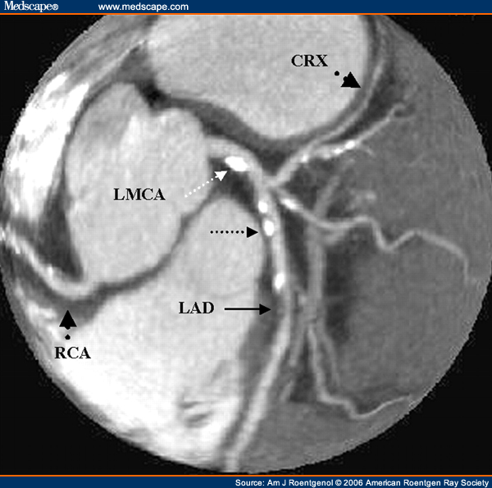
Coronary CT Angiography

Slide 42
COR Procedures 2007-2010

Slide 43
PCI Procedures 2007-2010

Slide 44
Coronary Angiography

Slide 45
I indeed was in the marines!

