Slide 1
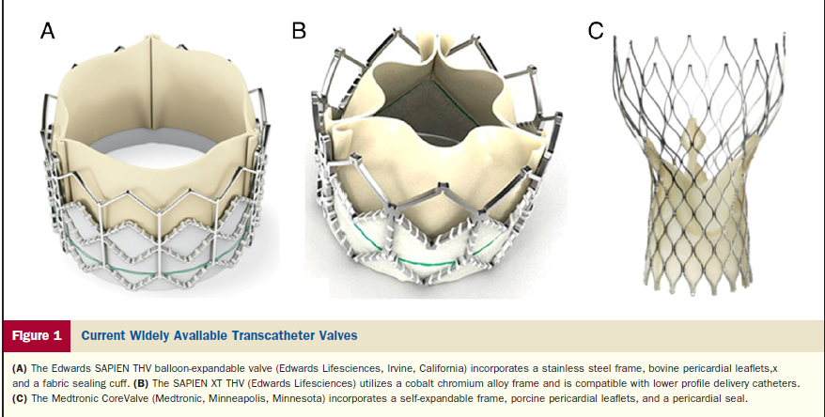
Trancatheter Aortic Valve Implantation (TAVI)
Georgios I. Papaioannou, MD, MPH, FACC, FSCAI
Director, Interventional Cardiologist
Athens Medical Center
Cardiac Catheterization Laboratory
4/3/2015
www.epemvatikikardiolgia.gr

Slide 2
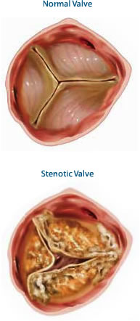
Aortic Valve Anatomy

Slide 3
Aortic Root Anatomy

Slide 4
Causes of Aortic Stenosis
Age related-Annular Calcification
History of Rheumatic Fever
Congenital Anomalies (Bicuspid Valve)
History of Chest Radiation
Autoimmune Diseases
Congenital Hypercholesterolemia
End-stage Renal Disease

Slide 5
Incidence of Aortic and Mitral Valve Disease

Slide 6
Natural History and Symptoms of Aortic Stenosis

Slide 7
Aortic Stenosis Treatment Algorithm

Slide 8
Choice of Surgival or Transcatheter Treatment of AS
Recommendations | Class | LOE
Surgical AVR in low or intermediate risk patients | I | A
TAVI or high-risk Surgery should be performed under Heart Team Guidance | I | C
TAVI for extremely high-risk patients + post TAVI predicted survival > 12 months | I | B
TAVI alternative to SAVR for high-risk patients | IIa | B
BAV as a bridge to TAVI or SAVR | IIb | C
TAVI not recommended in patients with comorbidities which preclude benefit | III | B

Slide 9
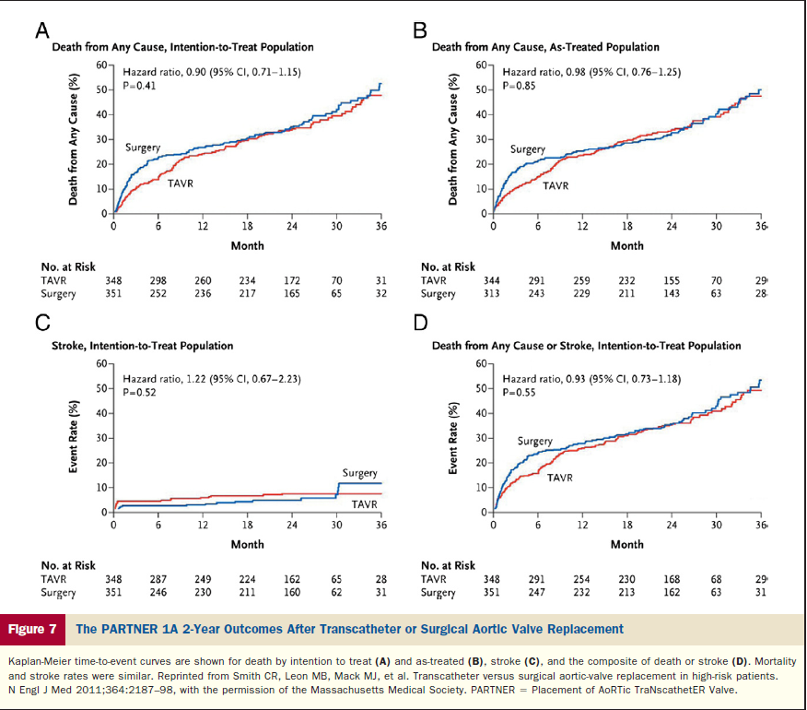
PARTNER 1A-2 year Results

Slide 10
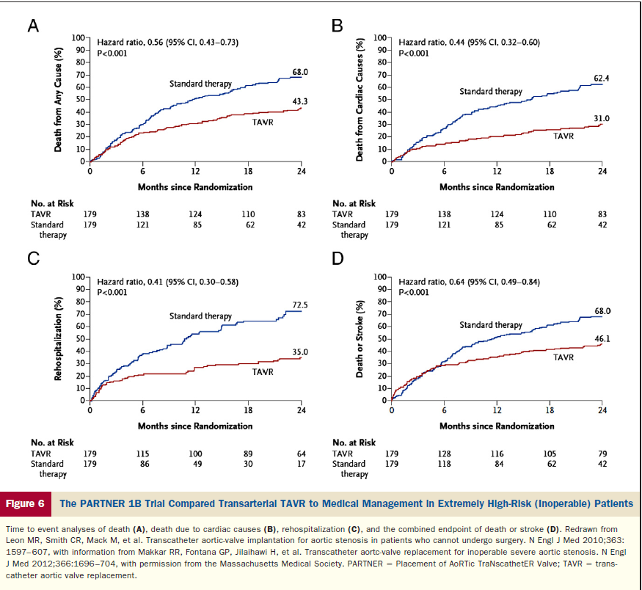
PARTNER 1B-Extremely High Risk Pts

Slide 11
US CoreValve Trial

Slide 12
US CoreValve Trial

Slide 13
US CoreValve Trial-Complications

Slide 14
TAVI Candidates

Slide 15
Worldwide TAVI Candidates

Slide 16
Wordwide TAVI Incidence Candidates

Slide 17
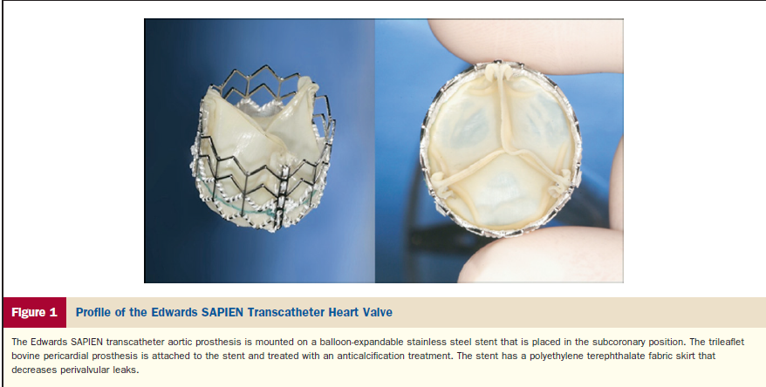
Edwards-Sapien XT Valve

Slide 18
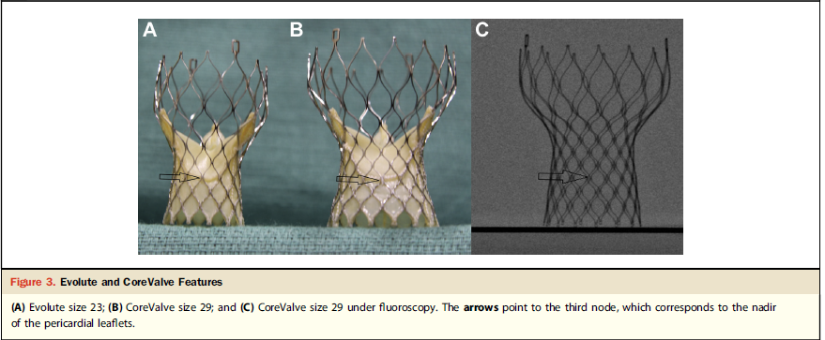
CoreValve

Slide 19
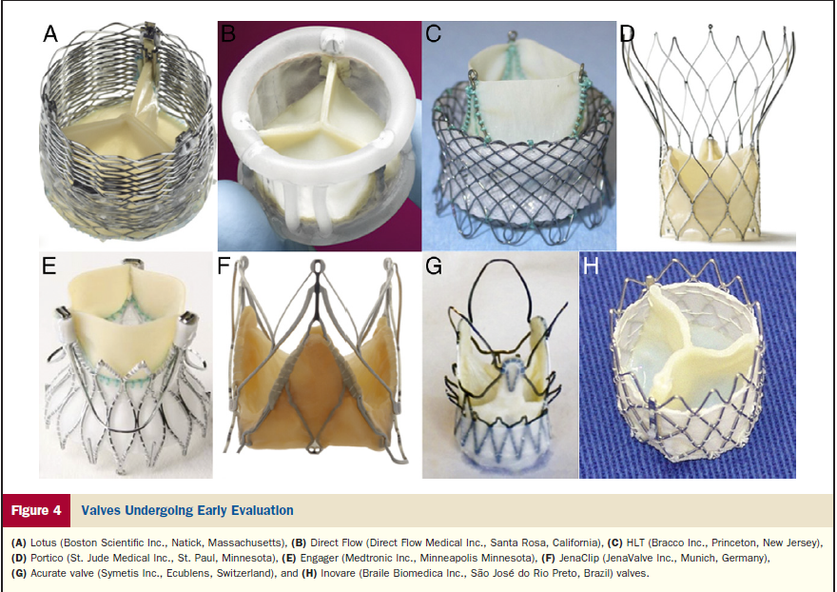
Valves Under Evaluation

Slide 20
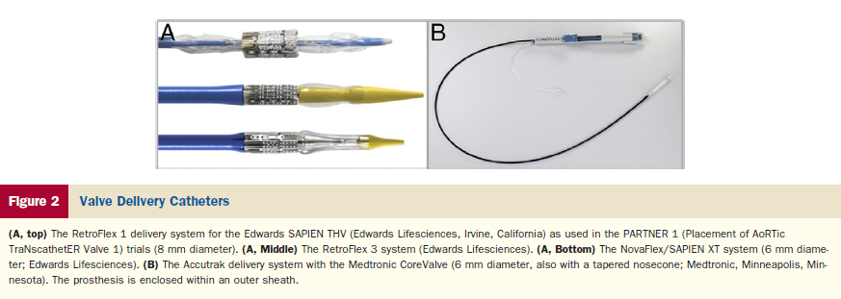
Valve Delivery Systems

Slide 21
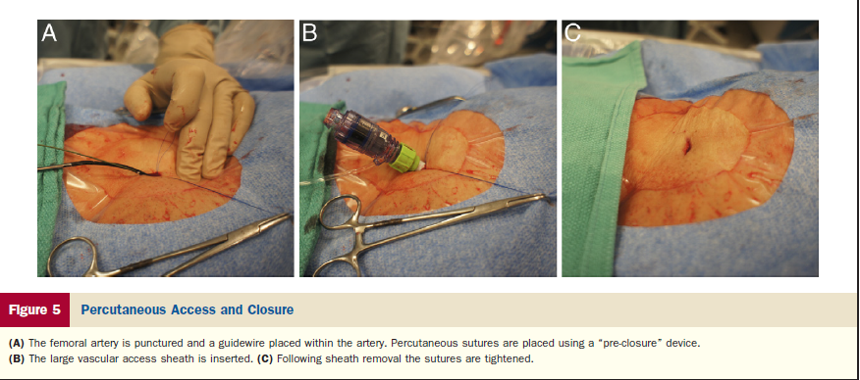
Preclose technique

Slide 22
TAVI Route

Slide 23
TAVI Screening
Euroscore > 20%
STS Score > 10%
Echocardiogram
Coronary Angiography
CT Angiography (Aorta & Peripherals)

Slide 24
CT Angiography (LVOT-Annulus-SOV-Aorta)

Slide 25
CT Angiography (Peripherals)

Slide 26
Screening Report

Slide 27
Fluroscopic Image of Valve Release (CoreValve)

Slide 28
Fluroscopic Image of Valve Release (Edwards-Sapien)

Slide 29
Femoral Arterial Puncture (1)

Slide 30
Femoral Arterial Puncture (2)

Slide 31
Sheath Insertion (14-22 F)

Slide 32
Baseline Aortography

Slide 33
Aortic Valvuloplasty

Slide 34
Valve Delivery System

Slide 35
Initial Valve Release (CoreValve)

Slide 36
Final Valve Release (CoreValve)

Slide 37
Femoral Angiography after closure

Slide 38
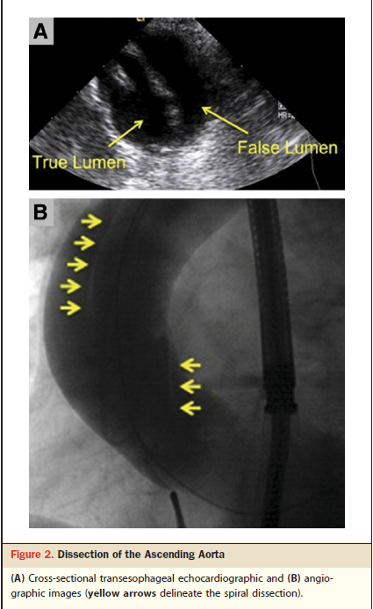
TAVI Vascular Arterial Complications

Slide 39
TAVI Transapical Complications

Slide 40
TAVI Mitral Valve Injury

Slide 41
TAVI Paravalvular Regurgitation

Slide 42
TAVI Annulus Rupture

Slide 43
TAVI Coronary Obstruction

Slide 44
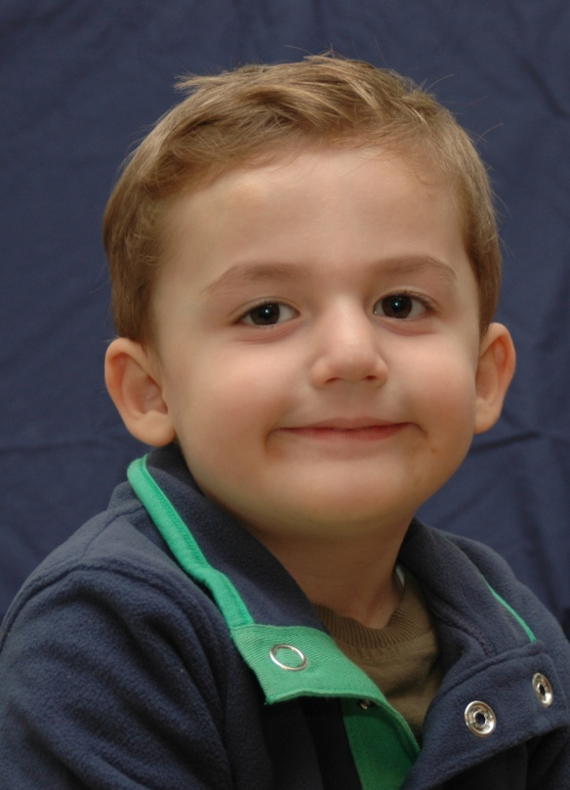
Θερμές Ευχαριστίες (2015)
Κατερίνα-Βασίλης
Αριέττα
Φίλιππος

