Slide 1

Bioresorbale Stents
Just an Alternative or One-Way Street?
Georgios I. Papaioannou, MD, MPH, FACC, FSCAI
Director, Cardiac Catheterization Laboratory
Athens Medical Center
29/10/2015

Slide 2
Bioresorbale Drug-Eluting Stents (BRS)
Breakthrough technology (after biodegradable polymers)
Stents disappear after their useful function (no local inflammatory reaction)
Restore vasomotor tone and endothelialization
Increase vessel diameter (positive remodeling)
Improve coronary physiology
Potentially decrease anginal burden

Slide 3
Bioresorbale Drug-Eluting Stents (BRS)
Not currently all patients are candidates and lesions are suitable
Stent deployment requires optimal pre and post dilatation
Low threshold of intracoronary imaging techniques
Higher rate of early post-procedural stent thrombosis

Slide 4
Optimal BRS
Optimal short and mid term radial support with thin struts
Adequate deliverability, handling and flexibility for insertion
Consistency of drug elution
Integrity during resorption

Slide 5
Strategies of developing BRS
Backbone comprised of L-lactic acid polymer
  ABSORB stent (BVS): Everolimus-eluting stent (CE Mark, Abbot Vascular)
  DESolve stent: Myolimus/Novolimus-eluting stent (CE Mark, Elixir Medical Corporation)
  ART stent: No eluting drug (CE Mark, Terumo Corporation)
Magnesium-based scaffolds (with rare earth metals)
  AMS/DREAMS: Paclitaxel/Sirolimus-eluting stent (Biotronic)
Other (Desaminotyrosin, Polylactic anhydrate)
  REVA BRS/ReZolve: Paclitaxel/Sirolimus-eluting stent (Reva Medical)
  Ideal Biostent: Sirolimus-eluting stent (Xenogenics)

Slide 6
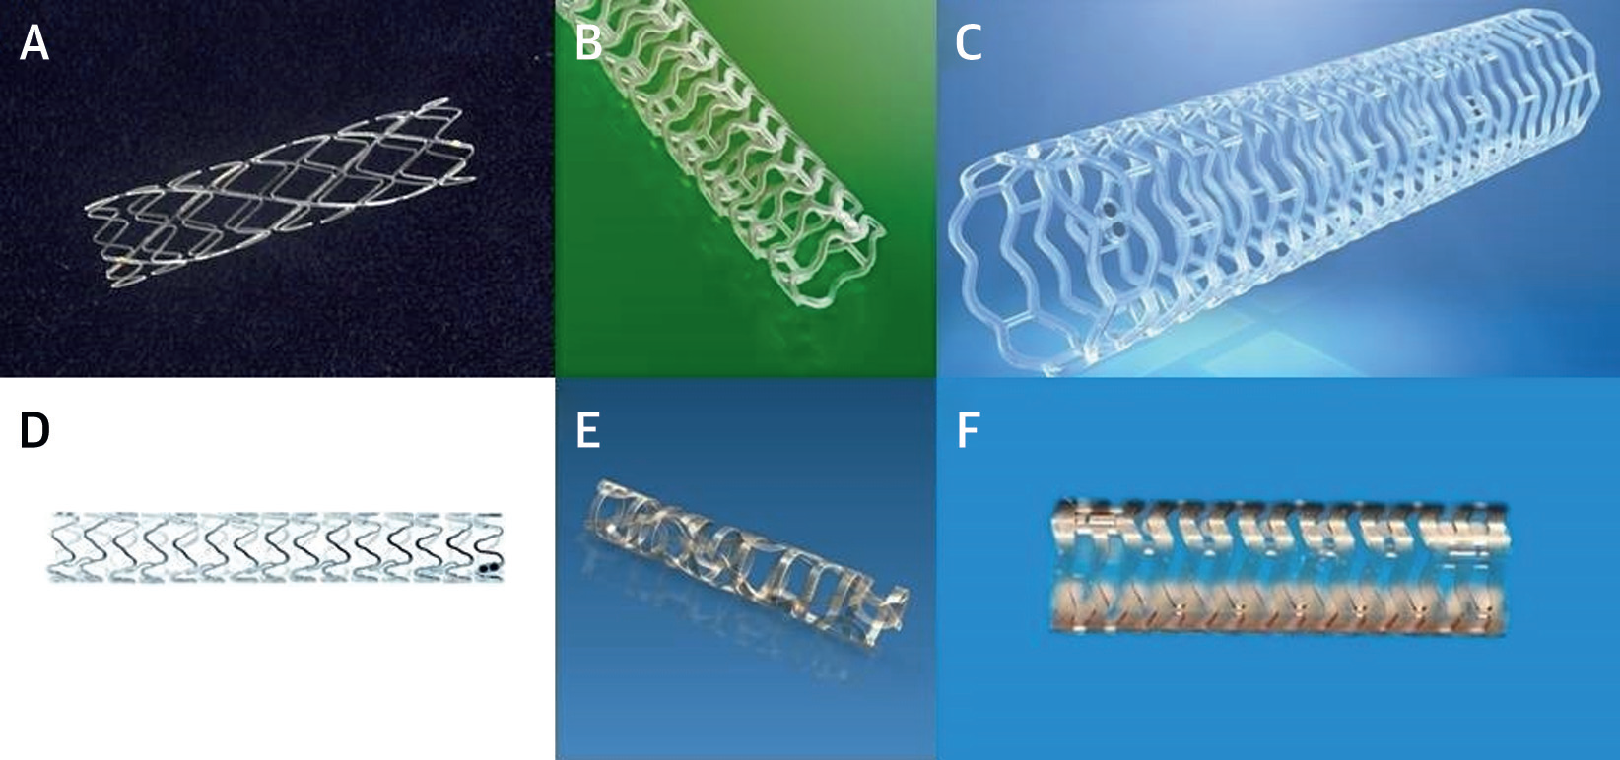
Types of BRS
A: Igaki-Tamai stent; B: ABSORB stent; C: DESolve stent; D: DREAMS Magesium alloy; E: ReZove BRS; F: Ideal BioStent

Slide 7
Igaki-Tamai Stent
PLLA-based BRS
Self-expandable when contrast dye heated at 80⁰ C
Initial results promising and vessel diameter increased at 3-year follow-up
Requires 8F Catheter
Heated contrast dye may cause injury

Slide 8
Absorb BVS
PLLA-based stent
150 μm strut thickness (c/w 90 in current DES)
1:1 mixture of poly-D,L-lactic acid and everolimus
Degrades over time to H₂O and CO₂
Full hydrolytic degadration up to 3 years

Slide 9
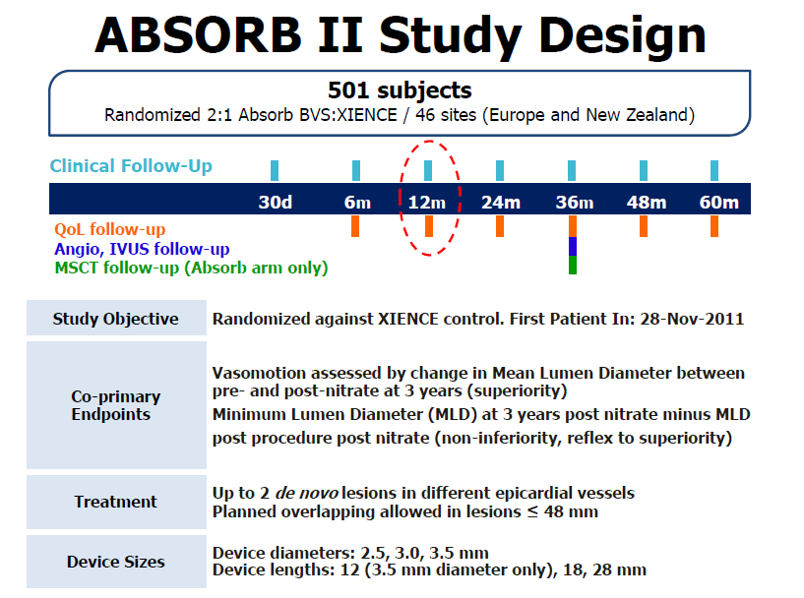

Slide 10
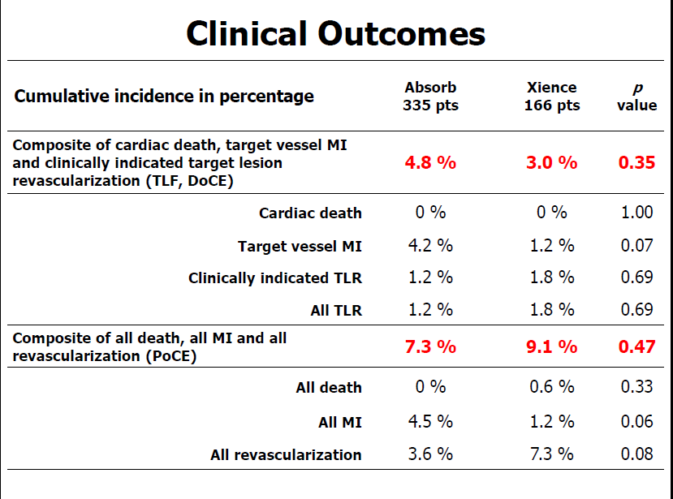

Slide 11
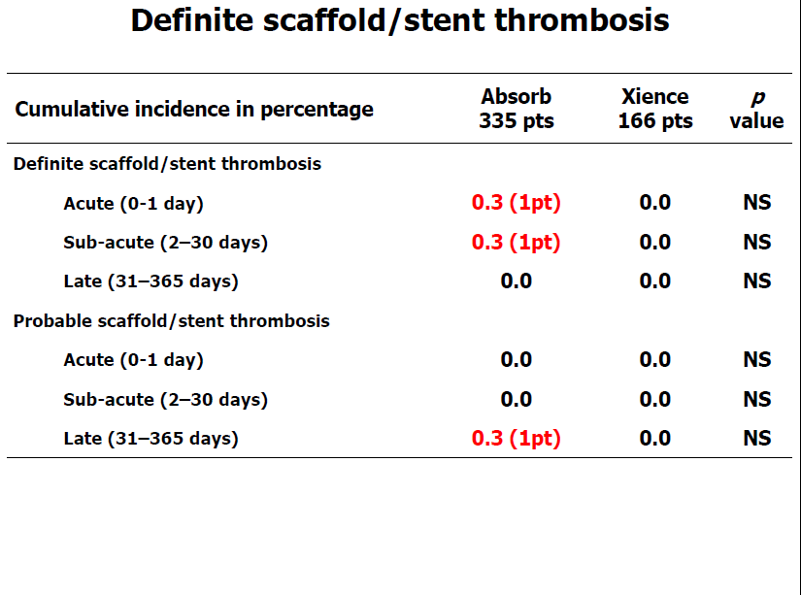

Slide 12
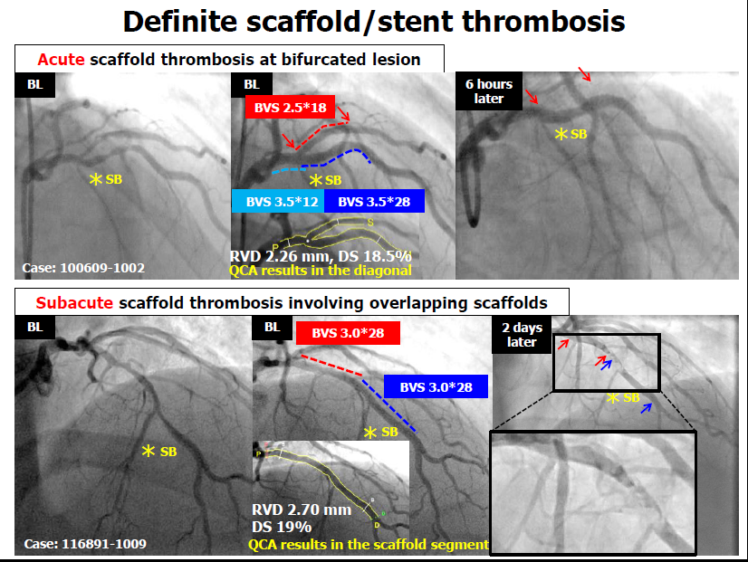

Slide 13
ABSORB III – 2008 Patients
Outcome | Absorb (1322) (%) | Xience (686) (%) | p
Target lesion failure | 7.8 | 6.1 | 0.16
Cardiac death | 0.6 | 0.1 | 0.29
Target vessel MI | 6 | 4.6 | 0.18
Ischemia-driven target lesion revascularization | 3 | 2.5 | 0.5
Ischemia-driven target vessel revascularization | 5 | 3.7 | 0.18
Patient-reported angina | 18.3 | 18.4 | 0.93
Definite or probable stent thrombosis | 1.5 | 0.7 | 0.13

Slide 14
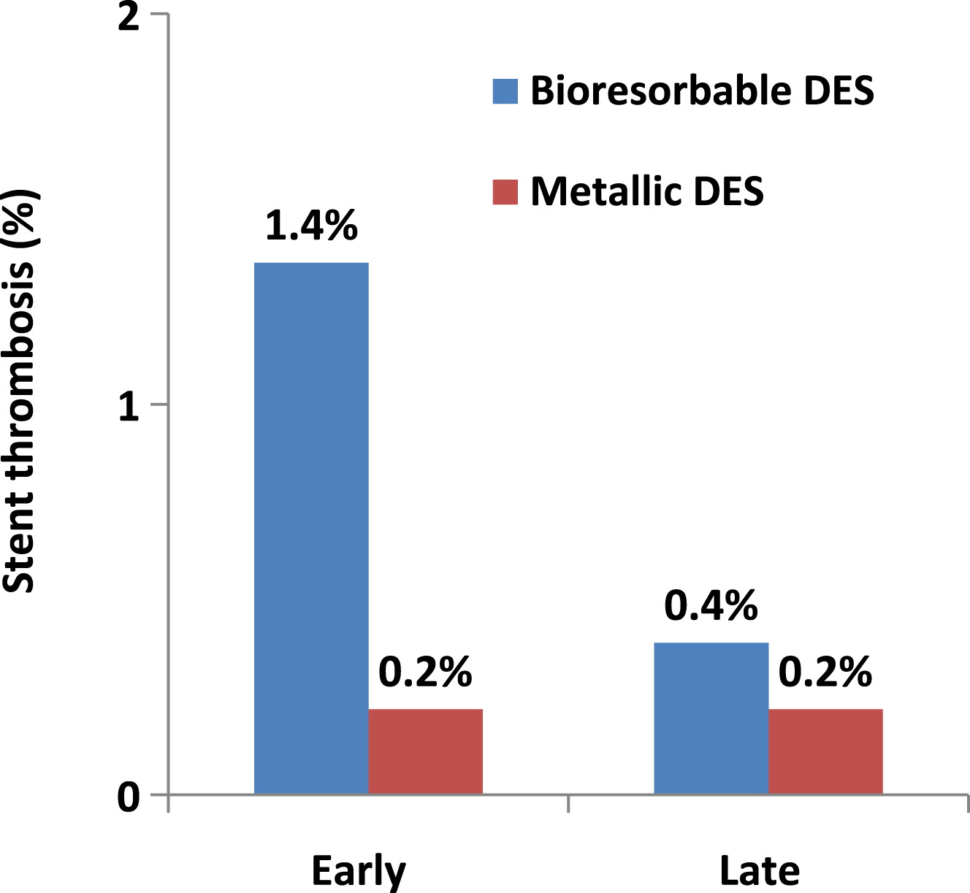
Rates of Stent Thrombosis after implantation of BRS vs BMS

Slide 15
DESolve BRS
PLLA based-stent
150 μm strut thickness
Novolimus eluting drug
Degrades to H₂O and CO₂ in 1 year
Device resorption time is 2 years
Wider range of expansion, reduced strut fracture, self-correction of minor malapposition

Slide 16
DESolve Nx Clinical Trial Design
Single de novo Coronary Artery Lesion
Reference vessel diameter: 2.75-3.0mm
Lesion length: <12mm, DAPT 12 months
3.0, 3.25, 3.5mm diameters; 14 and 18mm lengths
13 International Sites
Europe, New Zealand and Brazil
126 patients
Clinical MACE
30d
6mo
1yr
2yr
3yr
4yr
5yr
Angiographic
IVUS, OCT, MSCT (subset)
Primary Endpoint: 6-month in-scaffold late lumen loss
Secondary Endpoints:
  Clinical: Major Adverse Cardiac Events (cardiac death, target vessel MI, and clinically
  indicated TLR), Scaffold thrombosis
QCA: In-segment late lumen loss, binary restenosis, and percent diameter stenosis
  IVUS: In-scaffold percent volume obstruction, malapposition
  OCT: In-scaffold percent obstruction, strut coverage
  MSCT: Percent diameter stenosis, lumen area
Notes:
The DESolve NX study demonstrated consistent findings through multiple imaging modalities IVUS, OCT, QCA or multi scan CT.

Slide 17
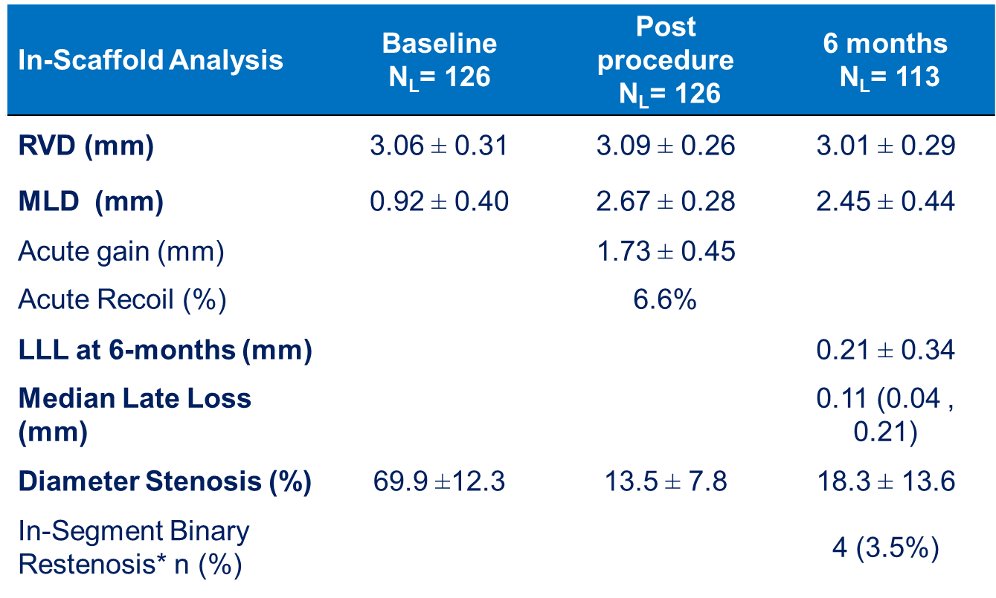
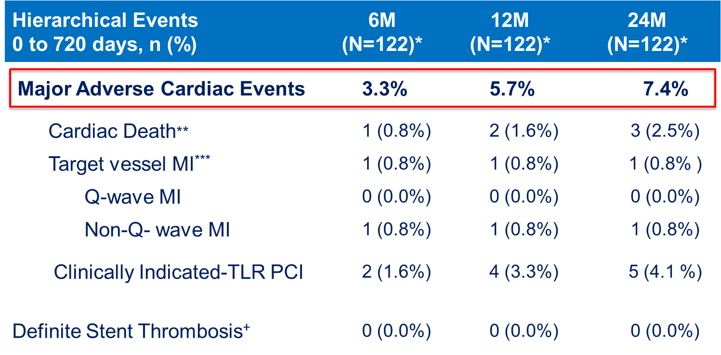
DESolve Nx showed excellent acute performance and low events through 2 years
EKE 2015

Slide 18
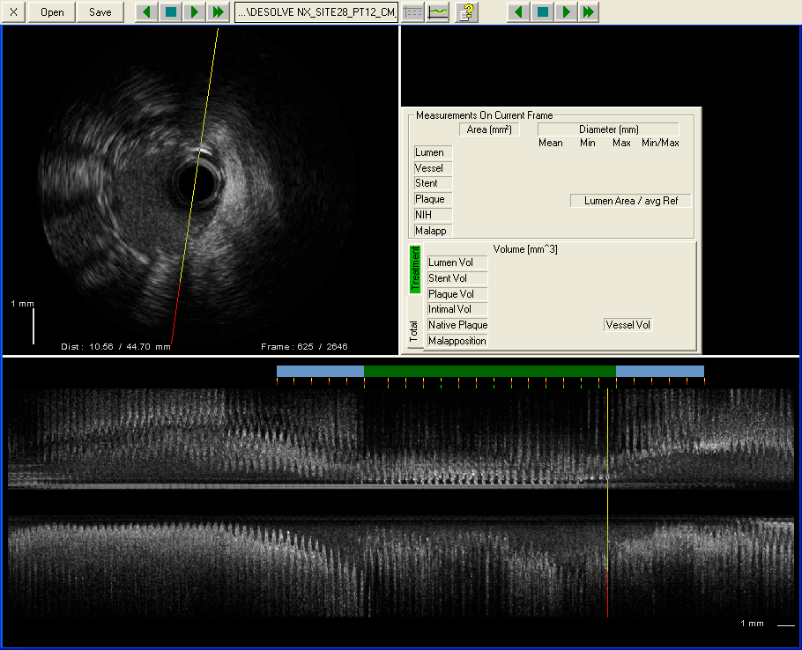
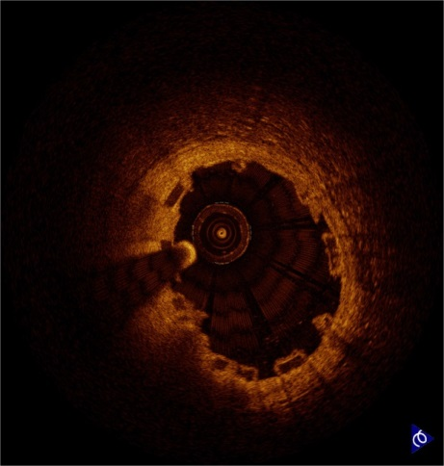
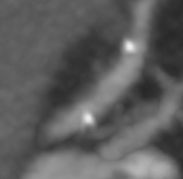
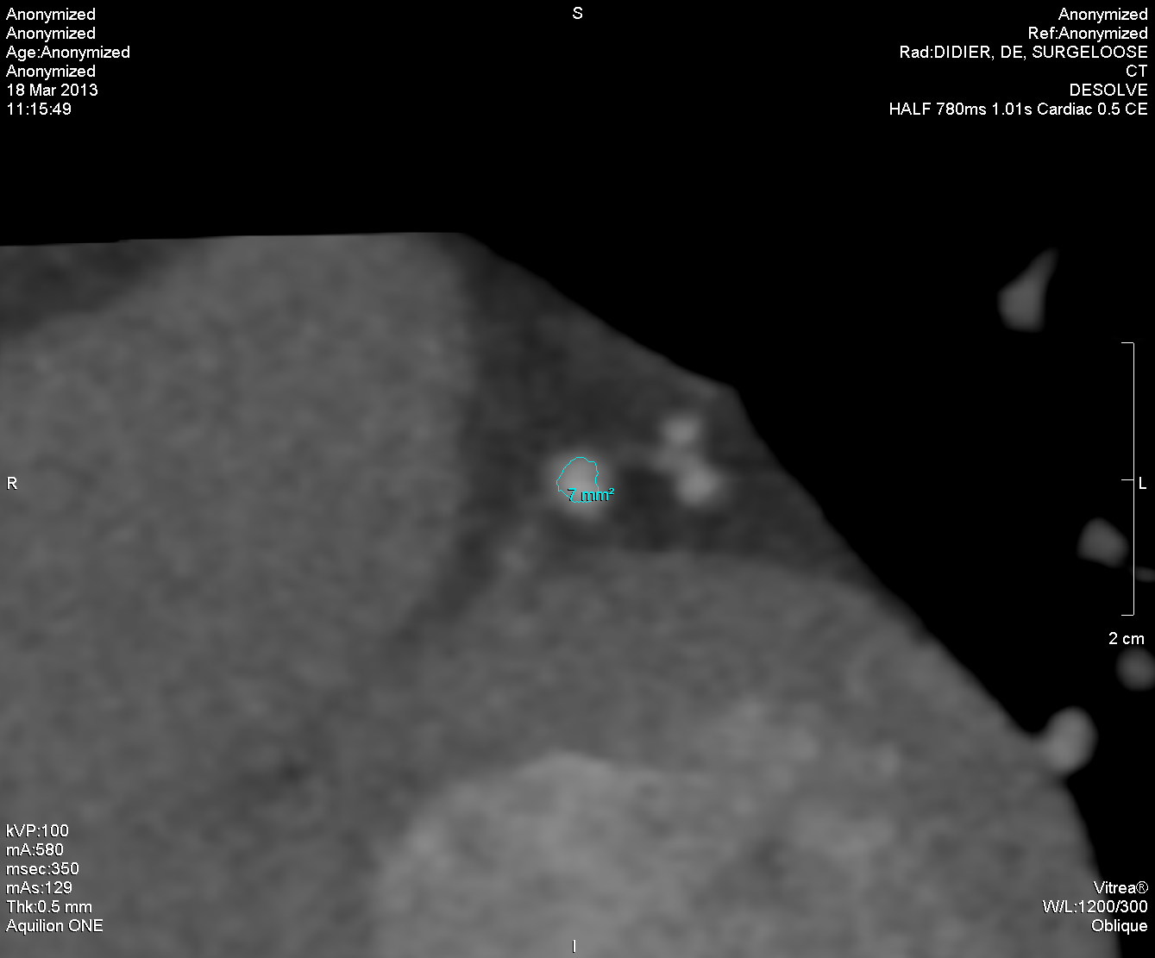
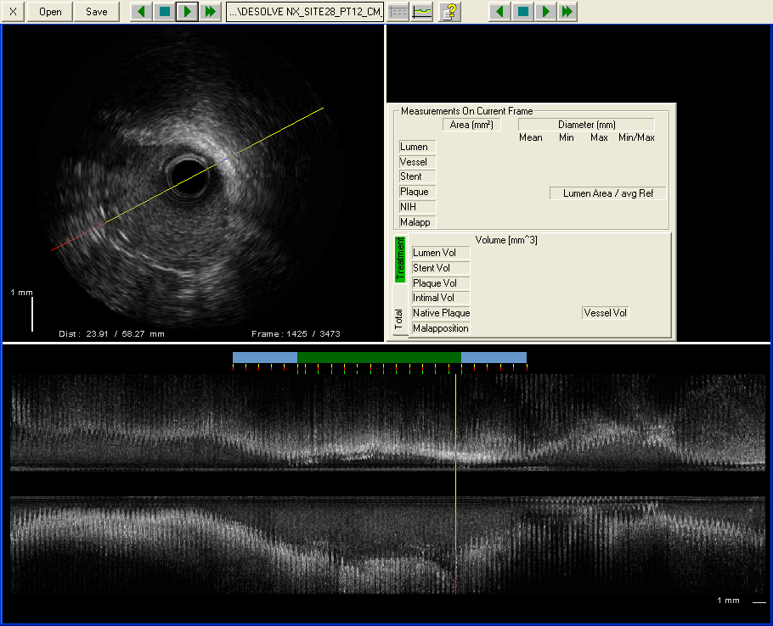
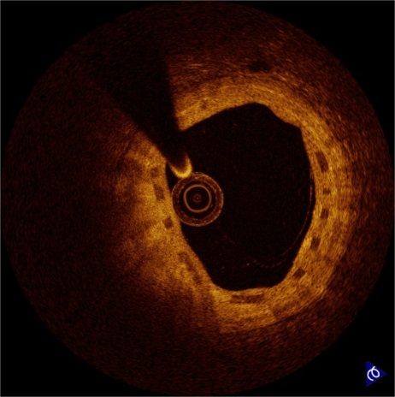
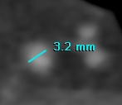
Case Example 1 - Multi-modality Imaging
Angio’s
IVUS/OCT
MSCT
Mean Scaffold Diameter = 3.1mm
Pre Procedure
SA = 6.09mm²
SA = 6.48mm²
SA = 7.00mm²
Post-PCI
Post-PCI
SA = 7.73mm²
SA = 9.50mm²
6 mos FU
6 mos FU
12 mos FU
Notes:
Throughout different imaging modalities and timeframes the results remain consistent. Reference: Dr Verheye DESolve First in Man

Slide 19
ART BRS
PLLA or PDLA based BRS
No eluting drug – next generation with eluting drug (Terumo)
Programmed dismantling at 3 months and resorption in 2 years
CE Mark based on ARTDIVA study 6 months results

Slide 20
DREAMS 2G
Magnesium-based BRS
120-150 μm strut thickness
Electronegative charge emerges during degradation with antithrombotic function
Paclitaxel to sirolimus (2G) eluting drug
Resorption time up to 12 months

Slide 21
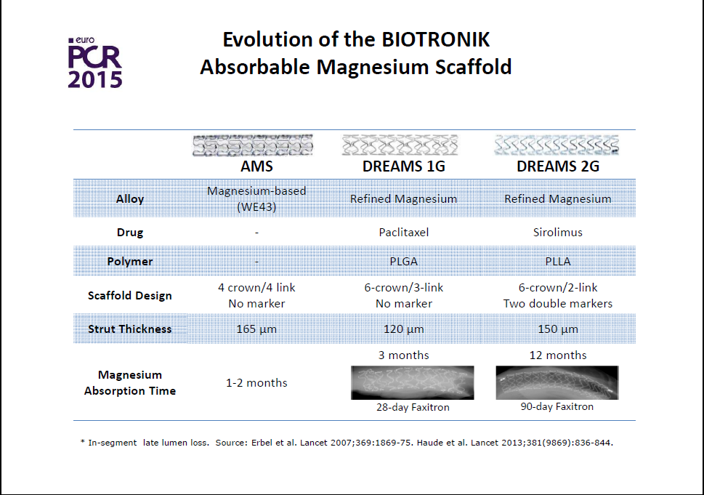

Slide 22
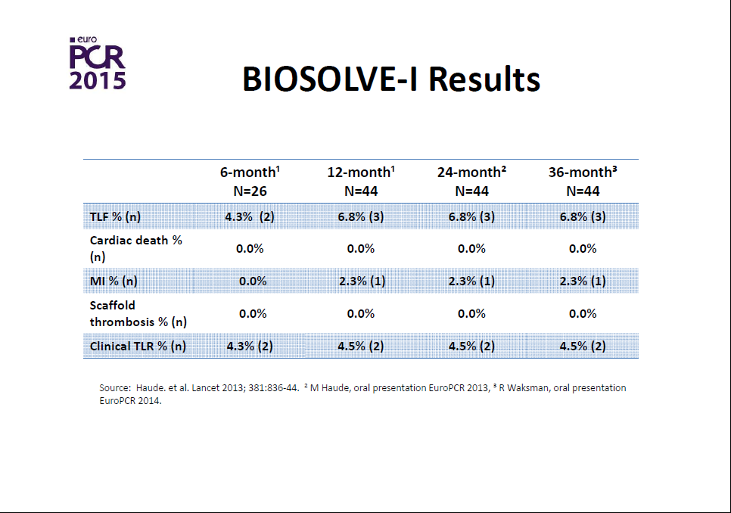

Slide 23
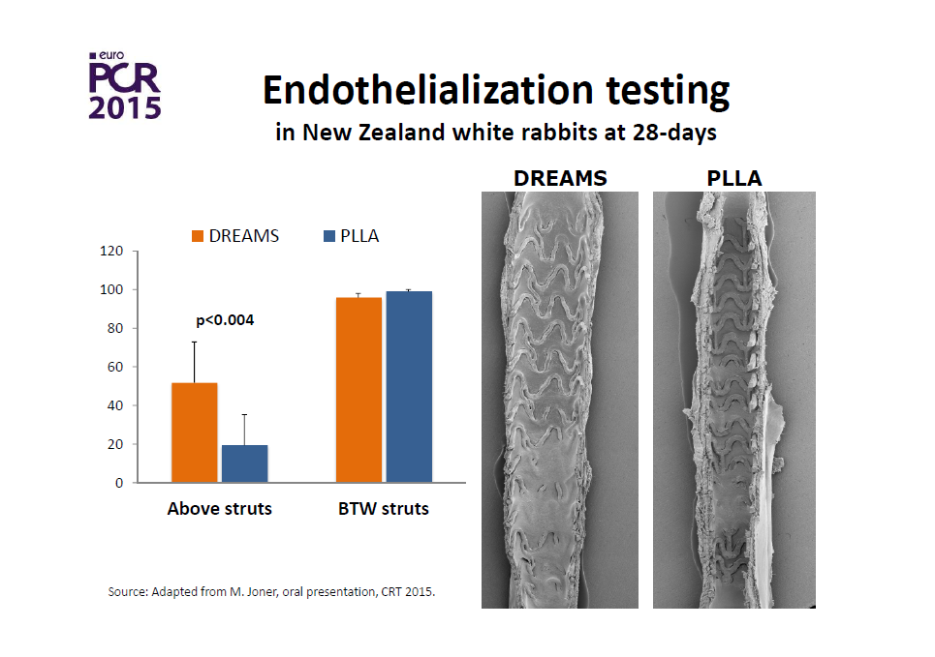

Slide 24
Safety and performance of the second-generation drug-eluting absorbable metal scaffold in patients with de-novo coronary artery lesions (BIOSOLVE-II): 6 month results of a prospective, multicentre, non-randomised, first-in-man trial
Between Oct 8, 2013, and May 22, 2015, we enrolled 123 patients with 123 coronary target lesions. At 6 months, mean in-segment late lumen loss was 0·27 mm (SD 0·37), and angiographically discernable vasomotion was documented in 20 (80%) of 25 patients. Intravascular ultrasound assessments showed a preservation of the scaffold area (mean 6·24 mm² [SD 1·15] post-procedure vs6·21 mm² [1·22] at 6 months) with a low mean neointimal area (0·08 mm² [0·09]), and optical coherence tomography did not detect any intraluminal mass. Target lesion failure occurred in four (3%) patients: one (<1%) patient died from cardiac death, one (<1%) patient had periprocedural myocardial infarction, and two (2%) patients needed clinically driven target lesion revascularisation. No definite or probable scaffold thrombosis was observed.

Slide 25
Conclusions
BRS represent an advancement in the interventional treatment of coronary disease
Current data are slightly inferior with respect to device success, recoil, MACE, lumen areas and TLR
Some possible benefits are only demonstrated in animal testing and small human cohorts
Data on various type of patients and lesions are limited
Technical considerations of deployment and imaging
Optimal duration of double antiplatelet therapy is unclear
However, current BRS limitations will likely be resolved in the near future

