Slide 1
Intravenous Antiplatelet Therapy in Coronary Artery Disease
Georgios I. Papaioannou, MD, MPH
Director, Cardiac Catheterization Laboratory
Athens Medical Center
ΙΜΕΘΑ 21/9/2017

Slide 2
Objectives
Platelet function and inhibition
Current intravenous antiplatelet agents
Abciximab
Eptifibatide
Tirofiban
Cangrelor
Key Notes

Slide 3
Platelet activation and aggregation
Hemostasis and Thrombosis
(GP) Ib – vWF interaction
Activation of GP IIb/IIIa receptors
Ligand binding* and platelet aggregation
* Fibinogen, vWF, fibronectin, vitronectin

Slide 4
Theurapeutic Targets
Cyclooxygenase 1 (prevents TXA2) - Aspirin
ADP Receptor P2Y12 - Clopidogrel, Prasugrel, Ticagrelor, Cangrelor
GP IIb-IIIa Antagonists– abciximab, eptifibatide, tirofiban
Thrombin receptor-Protease activated receptor 1 (PAR-1) (Inhibites thrombin-mediated platelet aggregation) - Vorapaxar, Atopaxar
Novel agents e.g Ab targeting vWf, GPIba receptor

Slide 5
Objectives
Platelet function and inhibition
Current intravenous antiplatelet agents
Abciximab
Eptifibatide
Tirofiban
Cangrelor
Key Notes

Slide 6
GP IIb/IIIa Antagonists
Abciximab
Murine Monoclonal Antibody
Binds rapidly – dissociates slowly
Not IIb/IIIa integrin-specific (Mac-1, Vitronectin)
Inhibits Thrombin generation
6% anti-abciximab antibodies
Eptifibatide - Tirofiban
Synthetic peptide (Sistrurus M. Barbouri - Echistatin)
Binds and dissociates rapidly
GP IIb/IIIa Integrin specific
Not immunogenic

Slide 7
Platelet Aggregation Inhibition Essays
Light Transmission Aggregometry (LTA)
Time consuming
Linear relationship
Anticoagulants (Sodium citrate, PPACK, UFH, EDTA)
Platelet agonists (ADP, thrombin)
Tirofiban (3.4-5 μM ADP) vs. abciximab/eptifibatide (20 μM)
>80%: surrogate inhibition
Rapid Platelet Function Essay (RPFA)
Bedside monitoring
Iso-TRAP agonist
Correlation with LTA not ideal
>80% target inhibition
>95% clinically tested
Notes:
Other essays
Platelet Function Analyzer 100
GP IIB/IIIa Receptor occupancy
Cone and Plate
Thromboelastography
Platelet Activated Clotting Time
Platelet Count Ratios
Clot Retraction

Slide 8
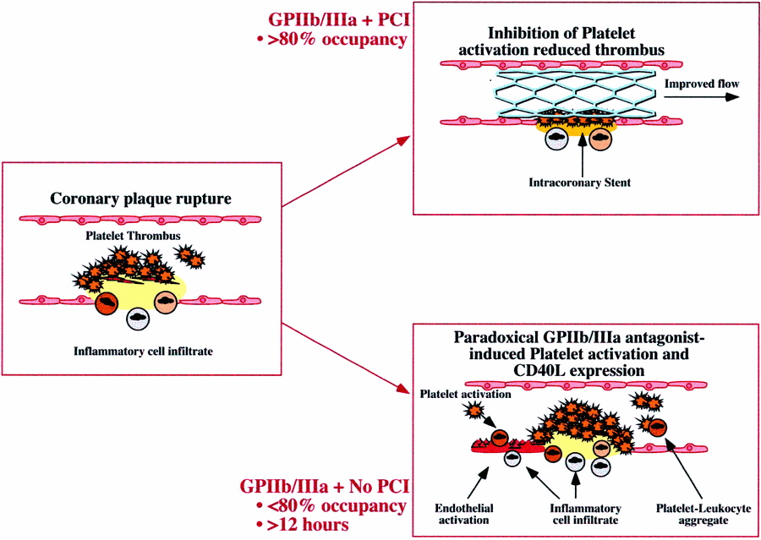
Prolonged exposure to low levels of platelet inhibition (<80%), enables paradoxical expression of GP IIb/IIIa pro-thrombotic effect
Quinn et al. Circulation 2002;106:379-85.

Slide 9
MACE Versus Platelet Inhibition by RPFA
14.4%
RRR 55%
P=0.006
MACE
6.4%
% inhibition at 10 minutes
The GOLD Trial. Circulation 2001;103:2572-78.

Slide 10
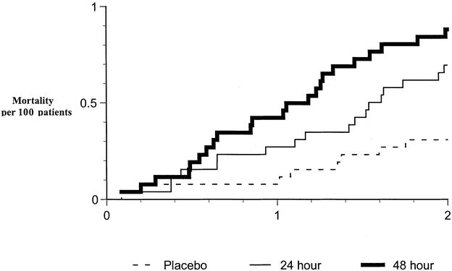
Clinical Implications: GUSTO IV-ACS
Increased mortality in the 24-hr (p=0.048) and 48-hr (p=0.007) abciximab groups. The curves separate early an continue to separate after 24 hrs. Circulation 2002;106:379-85.
Notes:
Significant platelet inhibition early during PCI
Loss of platelet inhibition 6 hrs after infusion in a significant proportion of patients

Slide 11
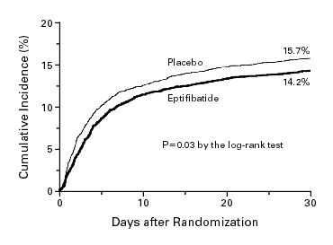
Clinical Implications: PURSUIT (ACS)
Kaplan–Meier Curves Showing the Incidence of Death or Nonfatal Myocardial Infarction at 30 Days. N Engl J Med 1998;339:436-443.
Notes:
Inadequate dosing - Single bolus - Double bolus

Slide 12
Initial Trials with GP IIb/IIIa Inhibitors during PCI
EPILOG* (Low Risk UA)
EPISTENT (40% SA)
ERASER
Kini et al (HSRA)
Tamburino et al
IMPACT
IMPACT-II* (42% ACS)
ESPRIT (12% ACS)
Harrington et al
Kereiakis et al
EPIC* (high-risk PCI)
EPISTENT (37% UA)
CAPTURE
Simoons et al
ISAR-2
IMPACT-II* (42% ACS)
RESTORE
RAPPORT
ADMIRAL
CADILLAC
Petronio et al (Rescue PTCA)
Modified from Karvouni et al. J Am Coll Cardiol 2003;41:26-32.
Notes:
HSRA: High Speed Rotational Atherectomy

Slide 13
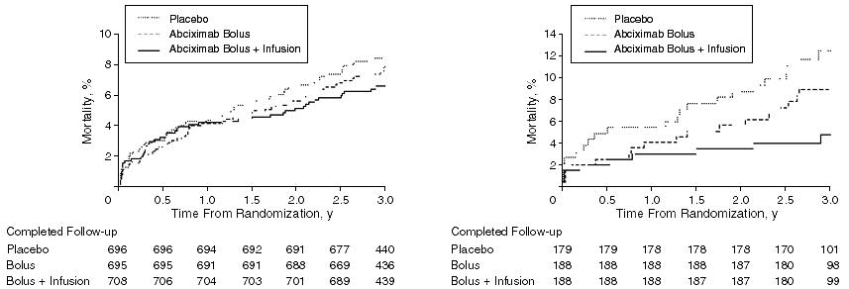
3-year EPIC Results
Mortality event curves for overall trial cohort by treatment assignment (Left, p=0.2) and mortality for the UA/MI subgroup (Right, p=0.01).
JAMA 1997;278:479-84.

Slide 14
CAPTURE 30-days Results
19%
P<0.05 for all comparisons
15.9%
11.3%
10.9%
8.2%
7.8%
4.1%
3.8%
Lancet 1997;349:1429-35. *Major Bleeding. MI lower rates in abciximab arm related to PTCA.

Slide 15
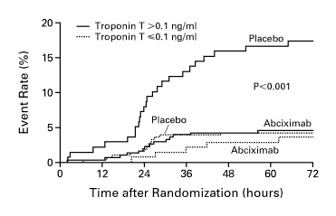
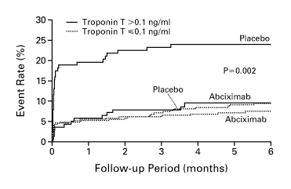
Results based on the Troponin Status in the CAPTURE Trial
Cardiac Events (death + MI) in the Initial 72 Hours (Left) and during the 6 Months of Follow-up (Right) among Patients with Serum Troponin T Levels above and those with Levels below the Diagnostic Cutoff Point.
N Engl J Med 1999;340:1623-29.

Slide 16
GP IIb/IIIa Inhibitors during Elective PCI: EPILOG
Patients with UA or ECG changes within the last 24 hours were excluded
ASA 325 mg, Standard versus Low-dose heparin
Primary Efficacy End point: Death, Non fatal MI, severe ischemia (TVR) at 30 days
No Plavix or Ticlid
Minimal % of stenting
N Engl J Med 1997;336:1689-96.

Slide 17
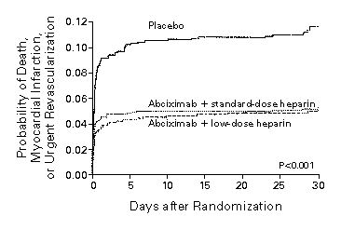
EPILOG 30-days Results
8.7%
*P<0.001
5.2%
3.7%
1.6%
Primary Composite End Point: 11.7% (Placebo), 5.4% (Low dose UFH) p<0.001. Heparin reduced minor but not major bleeding rates. N Engl J Med 1997;336:1689-96.

Slide 18
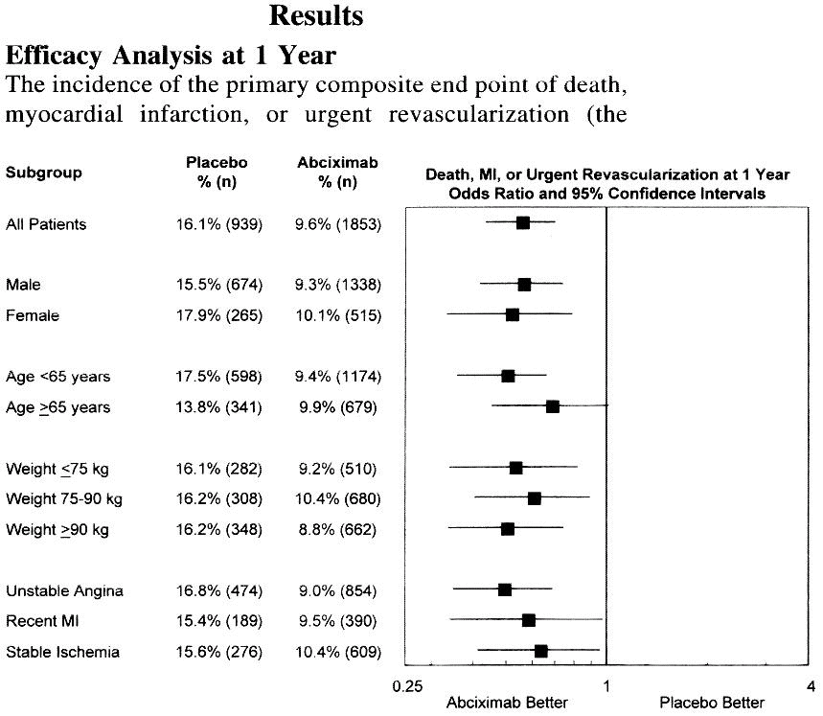
EPILOG 1-year Results: The higher the risk the greater the benefit of Abciximab during PCI
Circulation 1999;99:1951-8.

Slide 19
EPISTENT 6 months
P=0.01
P<0.001
P=0.003
P<0.001
P=NS
P=NS
Primary End Point: Death, MI or Repeated Target-Vessel Revisualization. Comparisons made between Stent+Abciximab and other groups. N Engl J Med 1999;341:319-27.

Slide 20
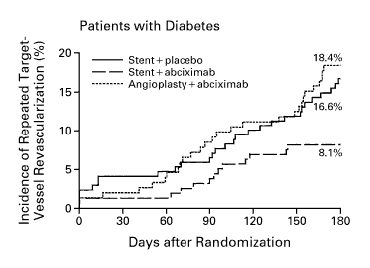
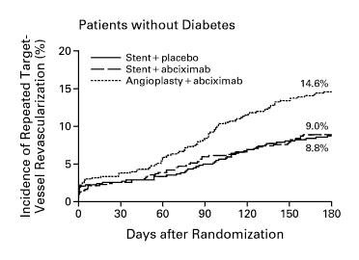
EPISTENT DM Subgroup (n=491, 20%)
RRR=51%
Among patients with DM, p=0.02 for the comparison between Stent+Abciximab and Stent+Placebo. Curves diverge at 60-90 days post-stent implantation. Among patients without DM p=0.002between PTCA +Placebo and Stent+Placebo. N Engl J Med 1999;341:319-27.

Slide 21
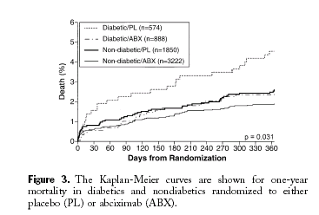
EPIC, EPILOG, EPISTENT DM Subgroups
P Value refers to the comparison between DM/PL - DM/ABX Groups. J Am Coll Cardiol 2000;35:922-28.

Slide 22
Following IMPACT-II: The ESPRIT Trial (“non-urgent PCI”)
RRR (MI): 33% over 6 months
Cumulative Incidence of Study End Points Among Patients Treated With Eptifibatide or Placebo. For the composite end point of death or MI, HR, 0.63; 95% CI, 0.47-0.84; P =.002. For the composite end point of death, MI, or target vessel revisualization, HR, 0.75; 95% CI, 0.60-0.93; P =.008. For the end point of death, HR, 0.56; 95% CI, 0.24-1.34; P =.19. JAMA 2001;285:2468-2473.

Slide 23
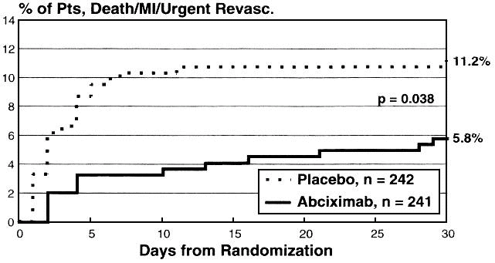
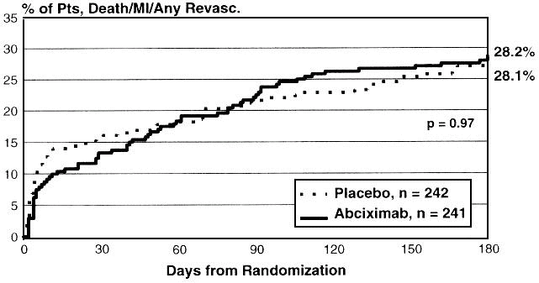
GP IIb/IIIa Inhibitors during STEMI + PTCA: RAPPORT
Both 30 days’ and 6 months’ composite end point was driven from TVR. 20% stents (PL) versus 12% (AB), p=0.008. Circulation 1998;98:734-41.

Slide 24
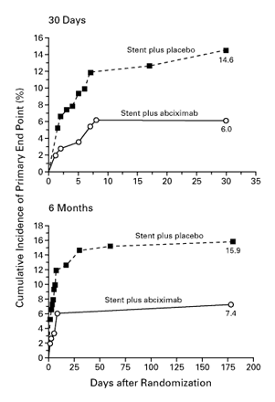
GP IIb/IIIa Inhibitors during STEMI + Stenting: ADMIRAL
Primary Composite End Point (UVR driven)
Death, Re-MI, UVR at 30 days
Key Secondary End Point (TVR driven)
Death, Re-MI, TVR (30 days/6 months)
Major bleeding
12.1% (AB) - 3.3% (PL), p=0.004
N Engl J Med 2001;344;1895-1903.

Slide 25
GP IIb/IIIa Inhibitors during STEMI: CADILAC
Hypothesis: Stenting was superior to PTCA and not inferior to PTCA+Abciximab with respect to composite end point. P values compare abciximab vs. non-abciximab groups.
N Engl J Med 2002;346:957-66.

Slide 26
ACUITY Study (ACC, March 2006)
Moderate and high risk unstable angina or NSTEMI undergoing an invasive strategy (N = 13,819)
UFH or
Enoxaparin
+ IIb/IIIa
Medical
management
Moderate
and
high risk
ACS
PCI
Bivalirudin
+ IIb/IIIa
R*
Angiography within 72h
Aspirin in all
Clopidogrel
dosing and timing
per local practice
Bivalirudin
Alone
CABG
*Stratified by pre-angiography thienopyridine use or administration
ACUITY Design. Stone GW et al. AHJ 2004;148:764–75

Slide 27
Study Design – Second Randomization
Moderate-high risk unstable angina or NSTEMI undergoing an invasive strategy (N = 13,800)
UFH or Enoxaparin
Routine upstream GPI in all pts
Routine upstream
GPI in all pts
R
GPI started in CCL for PCI only
VS.
UFH, Enoxaparin,
or Bivalirudin
Moderate-
high risk
ACS
Bivalirudin
Routine upstream GPI in all pts
Deferred GPI
for PCI only
R
GPI started in CCL for PCI only
Primary analysis
Aspirin in all
Clopidogrel
dosing and timing
per local practice
Bivalirudin
Alone
Secondary
analysis
ACUITY Design. Stone GW et al. AHJ 2004;148:764–75

Slide 28
Summary Conclusions ACUITY Timing Trial
Routine upstream
GPI in all pts
Deferred GPI
for PCI only
Net Composite
Outcome
11.7%
11.7%
P_{NI} <0.0001
Ischemic Composite
7.1%
7.9%
P_{NI} = 0.044*
P_{Sup} = 0.13
Major Bleeding
6.1%
4.9%
P_{Sup} = 0.009
*RR [95%CI] = 1.12 [0.97-1.29]

Slide 29
Study Design
2 of 3 high-risk criteria:
1. Age > 60 years
2. + CKMB or TnT/I
3. ST ↓ or transient ST ↑
(Or age 50-59, h/o CVD
and + CKMB or TnT/I)
High-risk NSTE ACS n = 10,500
Routine, early eptifibatide (180/2/180)
Placebo / delayed provisional eptifibatide pre-PCI
Randomize within 12 hours of presentation
Invasive strategy: 12 to 96 hours after randomization
Safety Endpoints at 120 hrs: Bleeding (GUSTO and TIMI scales), Transfusions, Stroke, Non-hemorrhagic SAEs
Primary Endpoint: 96-hr Death, MI, Recurrent ischemia requiring urgent revascularization, or Thrombotic bailout
Key Secondary Endpoint: 30-d Death or MI

Slide 30
Kaplan-Meier Curves for Primary Endpoint
15
10.0%
10
Delayed provisional eptifibatide
9.3%
Death, MI, RIUR or TBO (%)
P = 0.23
5
(stratified for intended early clopidogrel use)
Routine early eptifibatide
0
0
8
16
24
32
40
48
56
64
72
80
88
96
Time Since Randomization (Hours)

Slide 31
Small Molecule GP IIb/IIIa Inhibition in NSTE ACS
PURSUIT
PRISM
PRISM PLUS
Theroux
PARAGON B
PARAGON A
0.88 (0.79-0.97)
COMBINED 1998 (n = 23,967)
ACUITY Timing
EARLY ACS
0.92 (0.82-1.01)
EARLY ACS + ACUITY
0.89 (0.84-0.95)
COMBINED 2009 (n = 42,666)
0.25
0.50
1.0
2.0
4.0
Odds Ratio for 30-day Death or MI Relative to Control

Slide 32
Current Status of GPIIbIIIa antagonists
Newer oral agents (prasugrel, ticagrelor) with more rapid and reversible action
Aggressive interventional treatment of ACS
STEMI: No Class I (ESC, ACC)-Bailout Rx if no reflow, thrombus or thrombotic complication (IIa)-Routine or upstream use in high risk transfer patients (IIb)-Not recommended if PCI is not intended (III)
NSTEMI: In high risk patients, not adequately Rx with oral agents Class I (ACC), otherwise IIb.

Slide 33
Objectives
Platelet function and inhibition
Current intravenous antiplatelet agents
Abciximab
Eptifibatide
Tirofiban
Cangrelor
Key Notes

Slide 34
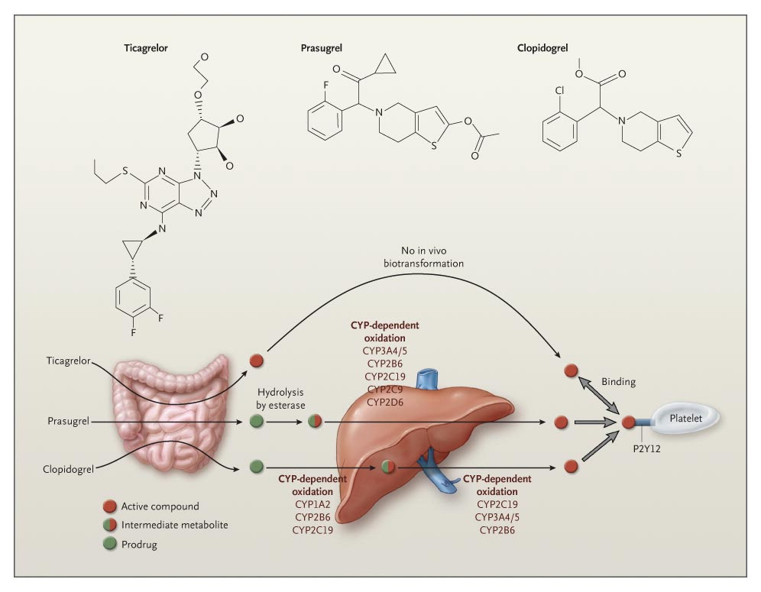
Schömig A. N Engl J Med 2009;361:1108-1111.
Biotransformation and Mode of Action of Clopidogrel, Prasugrel, and Ticagrelor: P2Y12 Receptor
Cangrelor: IV P2Y12 Antagonist-No conversion to active metabolite, ½ life 2.9-5.5 min-onset within 2 min-offset 60 min after infusion cessation-dose dependent action
Notes:
Figure 1. Biotransformation and Mode of Action of Clopidogrel, Prasugrel, and Ticagrelor. Ticagrelor, a cyclopentyl triazolopyrimidine, is rapidly absorbed in the intestine. The absorbed drug does not require further biotransformation for activation. It directly and reversibly binds to the platelet adenosine diphosphate (ADP) receptor P2Y12. The half-life of ticagrelor is 7 to 8 hours. The thienopyridines prasugrel and clopidogrel are prodrugs. Their active metabolites irreversibly bind to P2Y12 for the platelet's life span. After intestinal absorption of clopidogrel, it requires two cytochrome P-450 (CYP)–dependent oxidation steps to generate its active compound. After intestinal absorption of prasugrel, it is rapidly hydrolyzed, by means of esterases, to an intermediate metabolite and requires one further CYP-dependent oxidation step to generate its active compound. Most of the CYP-dependent activation occurs in the liver. Relevant CYP isoenzymes involved in the activation of both clopidogrel and prasugrel are also shown. Their activity may be affected by genetic polymorphisms.

Slide 35
Cangrelor
Greater inhibition than clopidogrel
Phase II dose ranging study 4 mcg/kgr produce 100% platelet inhibition within 15 min, similar to abciximab
Simultaneous administration of cangrelor and clopidogrel prevents clopidogrel from inhibiting P2Y12 receptor – to maintain inhibition after cangrelor, clopidogrel must be administered after cessation of cangrelor

Slide 36
CHAMPION PCI-CHAMPION PLATFORM
Phase III studies to test Cangrelor vs Clopidogrel during PCI-Early termination (8882 Pts) due to low likelihood to achieve superiority in the primary end point
No difference in the combined endpoint, but mainly driven by a raise in CPK MB-Troponin
Pooled data from both suggest some benefit of cangrelor over clopidogrel

Slide 37
Notes:
background

Slide 38
Notes:
results

Slide 39
Notes:
results

Slide 40
CHAMPION PHOENIX
Intravenous cangrelor reduces risk of ischemic events due to potent platelet inhibition, rapid onset and offset and there is no need for pretreatment with other antiplatelet agents
Tested only against clopidogrel
Transition strategies to clopidogrel (after), prasugrel (after) and ticagrelor (pre) makes Rx more complicated
Once coronary anatomy is known both PCI and CABG can be performed without delay

Slide 41
Objectives
Platelet function and inhibition
Current intravenous antiplatelet agents
Abciximab
Eptifibatide
Tirofiban
Cangrelor
Key Notes

Slide 42
Is there still a role for IV antiplatelet agents in ACS
YES!
Advantages of IV route
GPIIbIIIa Inhibitors still needed during PCI (provisionally) in patients with high thrombotic risk, low bleeding risk and those without effective DAPT (2 hr onset of ticagrelor, prasugrel)
Cangrelor is the only P2Y12 IV antagonist with favorable results currently approved in patients undergoing PCI who have not been pretreated with an oral P2Y12 receptor inhibitor and not receiving a GPIIbIIIa inhibitor

