Slide 1
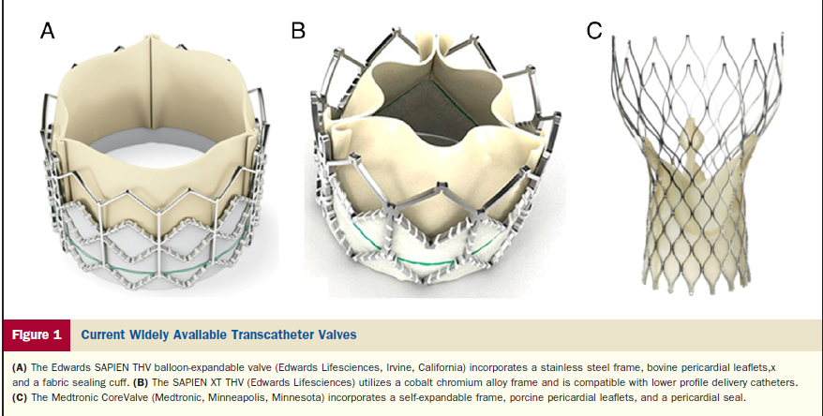
Trancatheter Aortic Valve Implantation (TAVI)
Georgios I. Papaioannou, MD, MPH, FACC, FSCAI
Director, Interventional Cardiologist
Athens Medical Center
Cardiac Catheterization Laboratory
10/4/2019
www.epemvatikikardiolgia.gr

Slide 2
Conflict of Interest
None

Slide 3
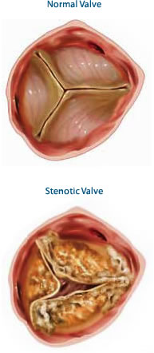
Aortic Valve Anatomy

Slide 4
Aortic Root Anatomy

Slide 5
Causes of Aortic Stenosis
Age related-Annular Calcification
History of Rheumatic Fever
Congenital Anomalies (Bicuspid Valve)
History of Chest Radiation
Autoimmune Diseases
Congenital Hypercholesterolemia
End-stage Renal Disease

Slide 6
Incidence of Aortic and Mitral Valve Disease

Slide 7
Natural History and Symptoms of Aortic Stenosis

Slide 8
Risk Assessment (STS/Frailty/Comorbidities/Procedure specific issues)
1. Low risk: STS <4% with no frailty, no comorbidity, and no procedure-specific impediments.
2. Intermediate risk: STS 4% to 8% with no more than mild frailty or 1 major organ system compromise not to be improved postoperatively, and minimal procedure-specific impediments.
3. High risk: STS >8%, or moderate-severe frailty, no more than 2 major organ system compromise not to be improved postoperatively, or a possible procedure-specific impediment.
4. Prohibitive risk: Preoperative risk of mortality and morbidity >50% at 1 year, ≥3 major organ system compromise not to be improved postoperatively, severe frailty, or severe procedure-specific impediments.

Slide 9
Frailty Index
J Am Coll Cardiol 2017;70:689-700

Slide 10
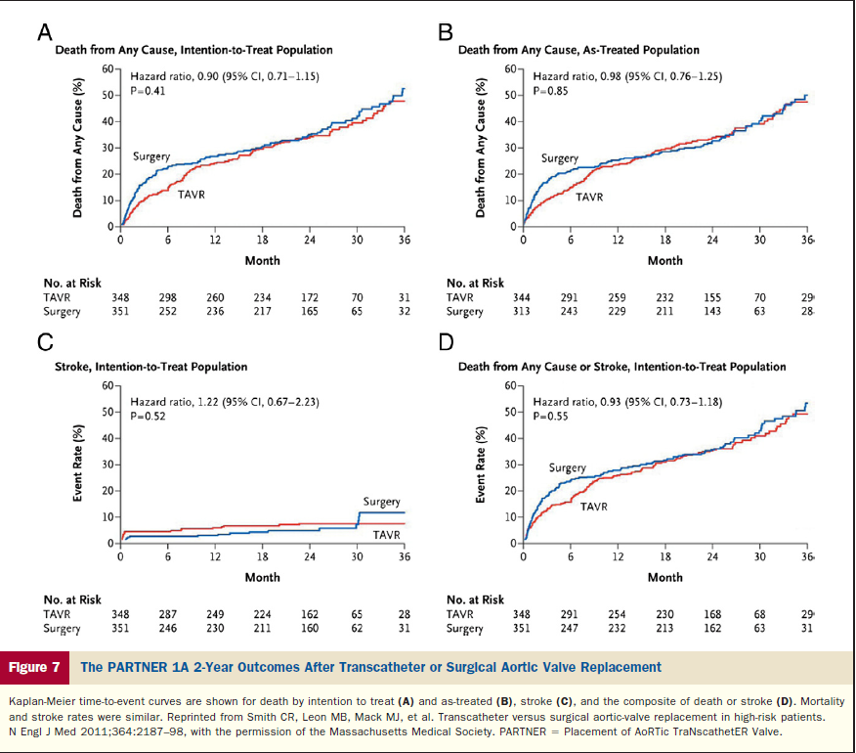
PARTNER 1A-2 year Results

Slide 11
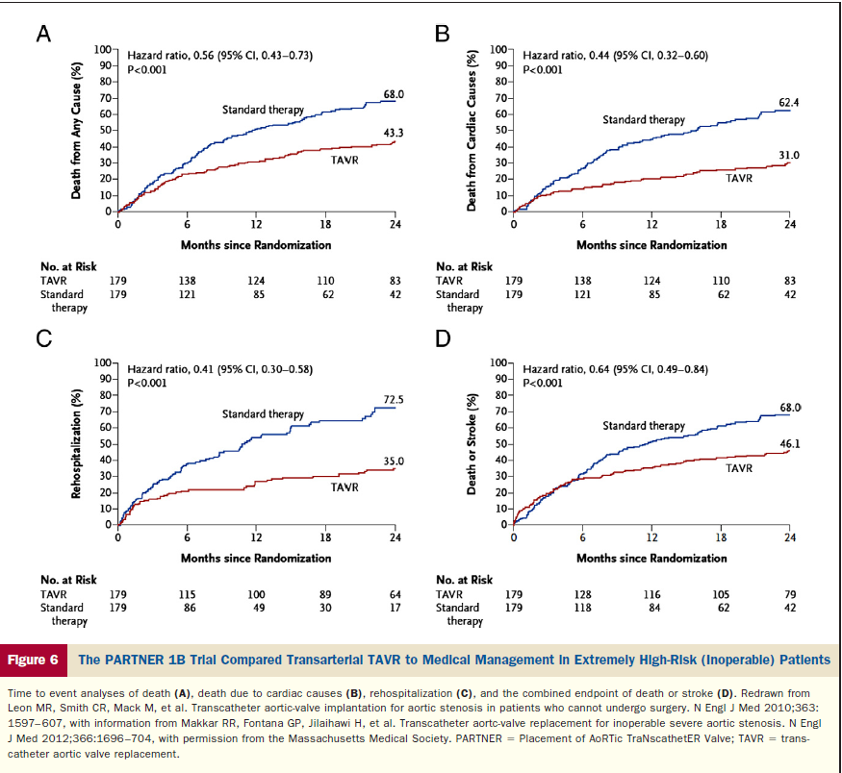
PARTNER 1B-Extremely High Risk Pts

Slide 12
US CoreValve Trial

Slide 13
US CoreValve Trial

Slide 14
US CoreValve Trial-Complications

Slide 15
Primary Endpoint-PARTNER 2A-Intermediate Risk All-Cause Mortality or Disabling Stroke (N Engl J Med 2016;374:1609-20
1
50
Surgery
HR [95% CI] = 0.87 [0.71, 1.07]
TAVR
p (log rank) = 0.180
40
30
All-Cause Mortality or Disabling Stroke (%)
21.0%
20
16.6%
18.9%
10
8.0%
14.0%
5.7%
0
0
3
6
9
12
15
18
21
24
Number at risk:
Months from Procedure
Surgery
944
826
807
779
766
743
731
715
694
TAVR
994
917
900
870
842
825
811
801
774

Slide 16
SURTAVI-CoreValve Trial in Intermediate Risk Patients (J Am Coll Cardiol 2017;70:252-89)

Slide 17
Choice of Surgival or Transcatheter Treatment of AS
Recommendations | Class | LOE
Surgical AVR in low risk patients | I | A
TAVI or high-risk Surgery should be performed under Heart Team Guidance | I | C
TAVI for extremely high-risk patients + post TAVI predicted survival > 12 months | I | B
TAVI for high-risk and intermediate-risk patients | I (high-risk) – I (Interm risk ESC) – IIa (Interm Risk ACC) | B
BAV as a bridge to TAVI or SAVR | IIb | C
TAVI not recommended in patients with comorbidities which preclude benefit | III | B

Slide 18
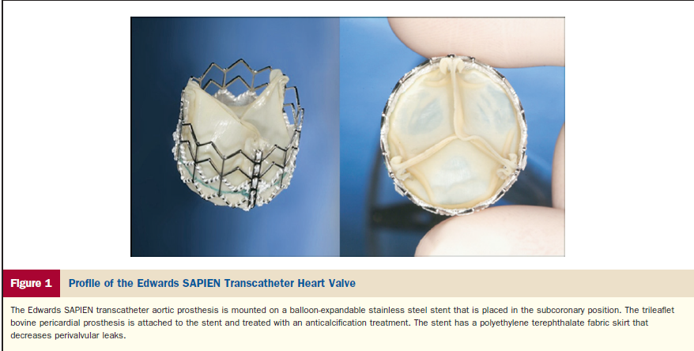
Edwards Sapien to Sapient XT to Sapien 3 and Centera self-expanding valveValve

Slide 19
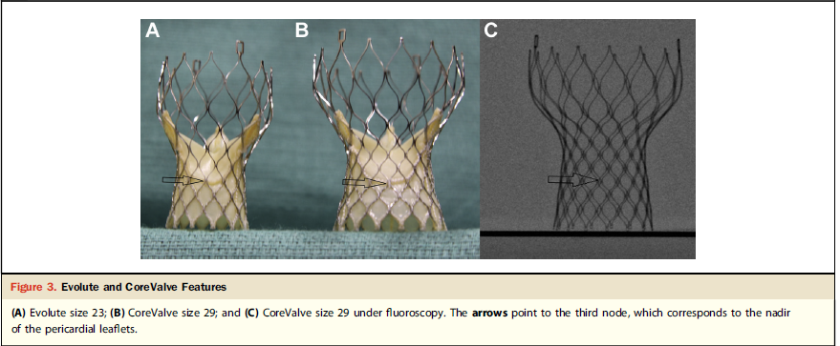
CoreValve to Evolut R to Evolut Pro

Slide 20
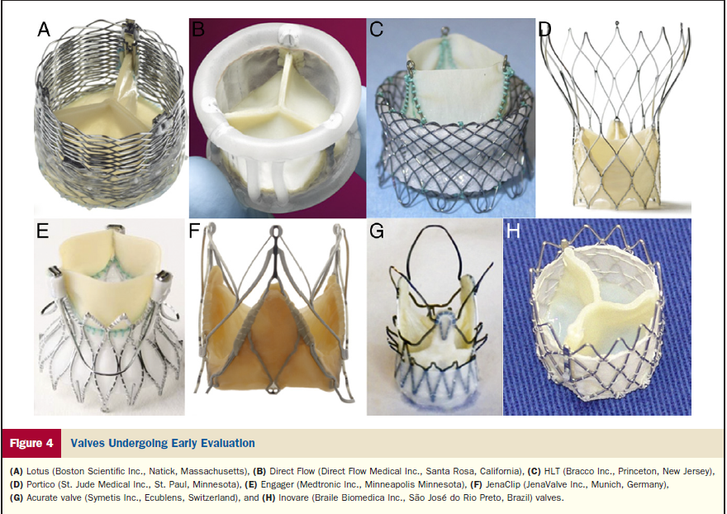
OtherValves

Slide 21
TAVI Route

Slide 22
TAVI Screening
Euroscore > 20%
Euroscore II > 7%
STS Score > 8%
Echocardiogram
Coronary Angiography
CT Angiography (Aorta & Peripherals)

Slide 23
CT Angiography (LVOT-Annulus-SOV-Aorta)

Slide 24
CT Angiography (Peripherals)

Slide 25
Screening Report

Slide 26
Fluroscopic Image of Valve Release (CoreValve)

Slide 27
Fluroscopic Image of Valve Release (Edwards-Sapien)

Slide 28
Femoral Arterial Puncture (1)

Slide 29
Femoral Arterial Puncture (2)

Slide 30
Sheath Insertion (3) (14-22 F)

Slide 31
Baseline Aortography (4)

Slide 32
Aortic Valvuloplasty (5)

Slide 33
Valve Delivery System (6)

Slide 34
Initial Valve Release (CoreValve) (7)

Slide 35
Final Valve Release (CoreValve) (8)

Slide 36
Femoral Angiography after closure (9)

Slide 37
TAVI through Aortic Stent (10)

Slide 38
Final Evolut R Placement (11)

Slide 39
AS - Lotus Valve – Aortography (12)

Slide 40
Final Placement of Lotus Valve (13)

Slide 41
Valve in Valve CE Magna 21(14)

Slide 42
Valve in Valve Evolut R (15)

Slide 43
TAVI in Bicuspid AV (23)

Slide 44
Sizing in Bicuspid AV (24)

Slide 45
Initial Result (25)

Slide 46
Balloon expansion (26)

Slide 47
Final Result (27)

Slide 48
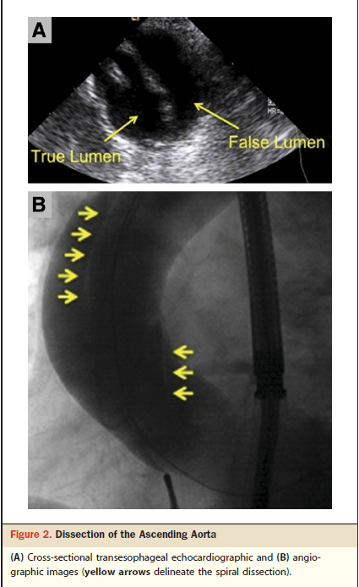
TAVI Vascular Arterial Complications

Slide 49
Femoral bleeding after puncture (16)

Slide 50
Femoral bleeding after puncture (17) – Use of RA

Slide 51
Femoral bleeding after puncture (18) – LFA for valve delivery

Slide 52
Femoral bleeding after puncture (19)

Slide 53
TAVI Transapical Complications

Slide 54
TAVI Mitral Valve Injury

Slide 55
TAVI Paravalvular Regurgitation

Slide 56
Paravalvular leak due to inadequate stent expansion (20)

Slide 57
Paravalvular leak due to inadequate stent expansion (21)

Slide 58
Paravalvular leak due to inadequate stent expansion (22)

Slide 59
TAVI Annulus Rupture

Slide 60
TAVI Coronary Obstruction

Slide 61
AMC TAVI Program
2015-Σήμερα
Επίσημη Πιστοποίηση από το ΚεΣΥ (2017)
Επιστημονικός Υπεύθυνος Κος Παπαϊωάννου Γεώργιος
Υποχρέωση ηλεκτρονικής αναφοράς περιστατικών και συμβαμάτων καθώς και ετήσιου ελέγχου κάθε τρίμηνο
Αναγκαιότητα στήριξης του προγράμματος (Υπ. Απόφαση 2018 – 40 περιστατικά ανά διετία με άριστα αποτελέσματα)
Πρόσφατη αδειοδότηση (2018) για MitraClip

Slide 62
AMC Cases n=42 - GP Cases n=32 (50)

Slide 63
TAVI GP Cases

Slide 64
TAVI GP Cases

Slide 65
TAVI GP Cases

Slide 66
Conclusions
TAVI indication for severe aortic stenosis is currently for patients with high-risk and intermediate risk >75 years for surgical aortic valve replacement
Technology is rapidly growing minimizing paravalvular leak and vascular complications due to reduced sheath size
It is anticipated over the next years to be implemented in the majority of intermediate risk patients provided proven duration of the bioprosthetic valve

